Slide 1
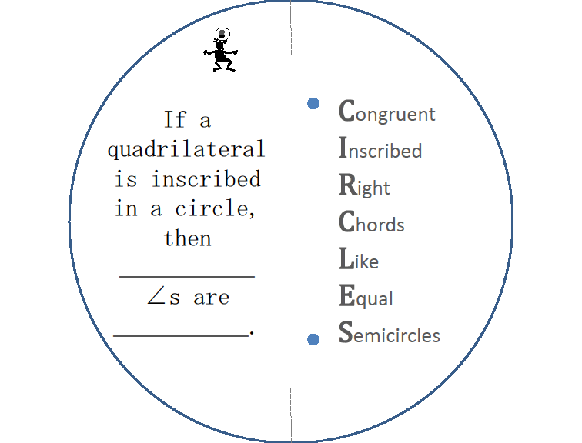
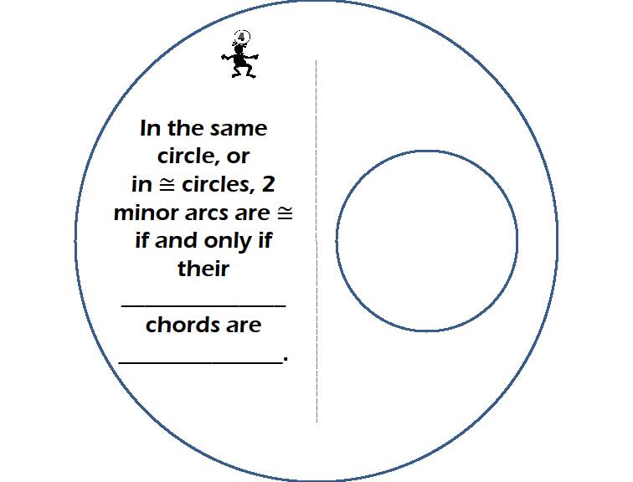
Circle Book
Cut out each circle.
Cut along the dotted lines ONLY!
© 2009, Dr. Jennifer L. Bell, LaGrange High School, LaGrange, Georgia (MCC9-12.G.C.2; MCC9-12.G.C.3; MCC9-12.G.C.4)

Slide 2
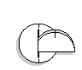
Group circles by dotted line pattern.
Order the pages:
Slide the 3 circles with
slits on the ends through
the large slit of the other 2 circles.
6. Write your name on it.
3, 2, 1
5,4
© 2009, Dr. Jennifer L. Bell, LaGrange High School, LaGrange, Georgia (MCC9-12.G.C.2; MCC9-12.G.C.3; MCC9-12.G.C.4)

Slide 3
8
Congruent
Inscribed
Right
Chords
Like
Equal
Semicircles
If a quadrilateral is inscribed in a circle, then ___________
∠s are ___________.

Slide 4
1
If a line is tangent to a circle, then the line is ____________
to the radius drawn at the point of tangency.

Slide 5

2
If 2 segments from the same exterior point are tangent to a circle, then they are _________.
**Hat rule!

Slide 6
7
An ∠ inscribed
in a semicircle
is a _________.

Slide 7
3
If a diameter
(or radius) of a circle is ⊥ to a chord, then the diameter (or radius) ___________
the chord & its arc.
If one chord is the ⊥ bisector of another chord, then the 1st chord is a ___________ .
**must run through the center!

Slide 8
6
If 2 inscribed ∠s intercept the same arc, then they are ________.

Slide 9
5
  In the same
  circle, or in ≅ circles, 2 chords are ≅ if and only if they are
  __________
  from the
  center.

Slide 10
9
Other tidbits:
* If 2 chords in a circle are ≅, then their 2 central ∠s are ________________.
*Parallel lines intercept ___________arcs on a circle.

Slide 11
4
In the same circle, or
in ≅ circles, 2 minor arcs are ≅ if and only if their
______________ chords are ______________.

Slide 12
© 2009, Dr. Jennifer L. Bell, LaGrange High School, LaGrange, Georgia
(MCC9-12.G.C.2; MCC9-12.G.C.3; MCC9-12.G.C.4)

