Slide 1
Summarizing the Methods
for Solving Quadratics
Foldable
Dr. Jennifer L. Brown, © 2013,
Columbus State University,
CRMC Summer Workshop
(MCC9‐12.A.SSE.1a; MCC9‐12.A.SSE.2; MCC9‐12.A.SSE.3a;
MCC9‐12.A.SSE.3b; MCC9‐12.A.REI.4a;
MCC9‐12.A.REI.4b; MCC9‐12.F.IF.8a)

Slide 2
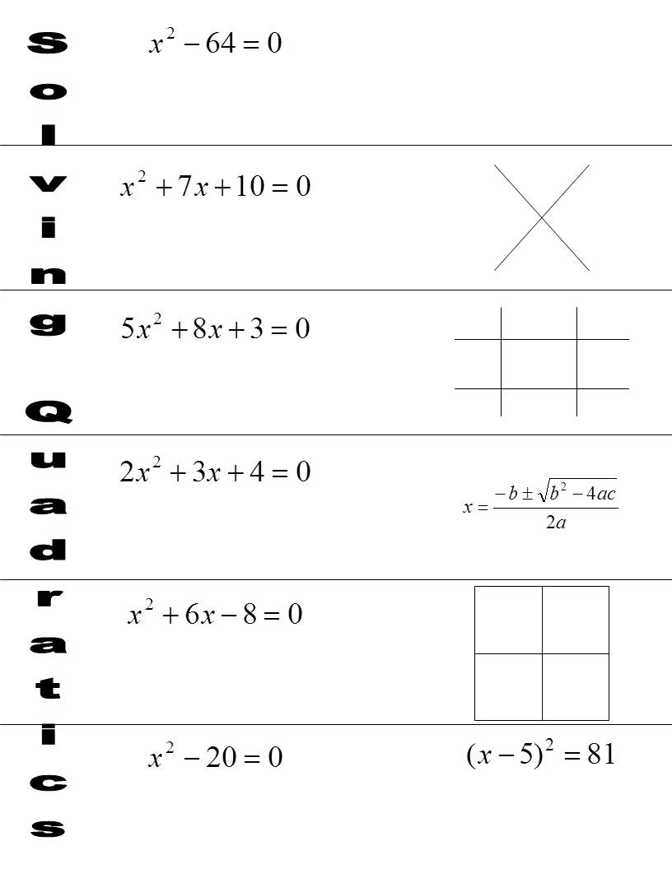
Directions
Fold the paper.
Cut along the lines.

Slide 3
(x – 8) (x + 8) = 0
x – 8 = 0 x + 8 = 0
+ 8
+ 8
- 8
- 8
x = 8
x = ⁻ 8
(x + 5) (x + 2) = 0
x + 5 = 0 x + 2 = 0
10
5
2
- 5
- 5
- 2
- 2
7
x = ⁻ 5
x = ⁻ 2

Slide 4
(5x + 3) (x + 1) = 0
5x + 3 = 0 x + 1 = 0
5
3
15
x = ⁻ ³/₅
5
- 3
- 3
- 1
- 1
x
1
5
5x = ⁻ 3
x = ⁻1
1
x
3
3
5
5
⁻10
(10)²
- 4(2)c
- 4(2)(4)
2(2)

Slide 5
⁻10
(10)²
- 4(2)(4)
2(2)
±
√
68
⁻10
100
- 32
x =
4
2 34
±
√
⁻10
68
2 17
x =
4
⁻ 5
1
±
√
±
√
x =
⁻5
17
⁻10
2 17
x =
2
2
4

Slide 6
x
+ 3
+ 8
+ 8
x
x²
+3x
x² + 6x = 8
(x + 3)² = 17
+ 9
+ 9
x + 3 = ± 17
√
√
+ 3
+3x
+9
√
- 3
- 3
√
x = ⁻3 ± 17

Slide 7
x
+ 3
+ 8
+ 8
x
x²
+3x
x² + 6x = 8
(x + 3)² = 17
+ 9
+ 9
x + 3 = ± 17
√
√
+ 3
+3x
+9
√
20
+ 20
+ 20
2 10
x² = 20
x = ± 20
x = ± 2 5
√
√
2 5
√
√

Slide 8
20
+ 20
+ 20
2 10
x² = 20
x = ± 20
x = ± 2 5
√
√
2 5
√
√
√
√
x – 5 = 9 x – 5 = ⁻9
+ 5
+ 5
+ 5
+ 5
x = 14
x = ⁻ 4

