Slide 1
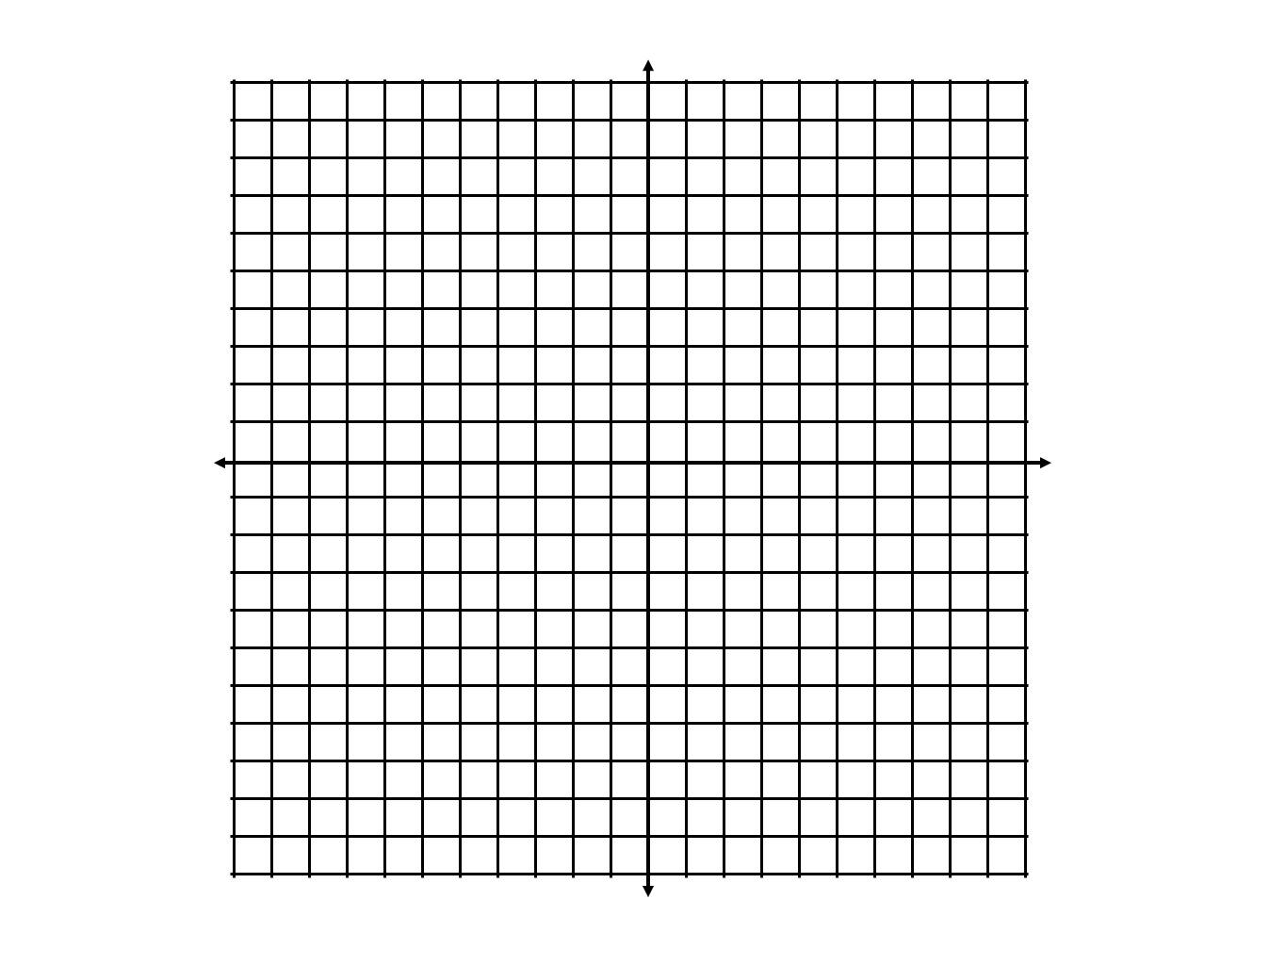
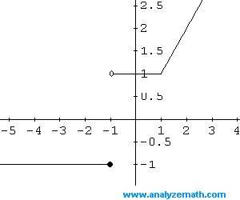
1. Graph f(x) = x² + 1.
2. Erase part of the graph.
What is the domain?
What is the NEW equation?
What are piecewise functions?
What are piecewise functions?
A __________ function consists of different function rules for different parts of the domain.
©2010, Dr. Jennifer L. Bell, LaGrange High School, LaGrange, Georgia Adapted from Various Sources MCC9-12.F.IF.7b

Slide 2
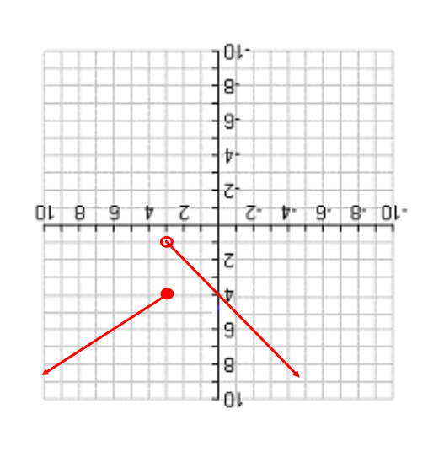
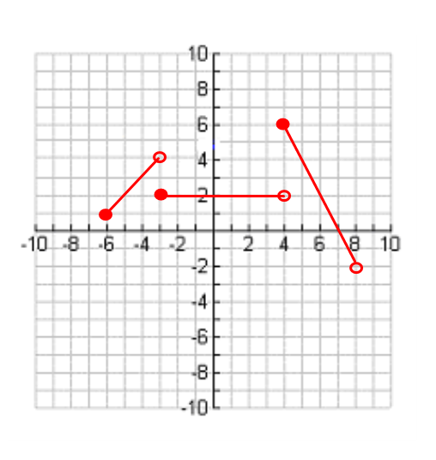
What is the domain for the first (left) ray? The Range?
What is the domain for the second (right) ray? The Range?
Characteristics
What do these symbols mean?
_____________ _____________
What is the domain for the first (left) segment? The Range?
What is the domain for the second (middle) segment? The Range?
What is the domain for the third (right) segment? The Range?
How many equations do you think you would have to use to write rule for the following piecewise function?
Characteristics
©2010, Dr. Jennifer L. Bell, LaGrange High School, LaGrange, Georgia Adapted from Various Sources MCC9-12.F.IF.7b

Slide 3
How many pieces does your graph have? Why?
Are the pieces rays or segments? Why?
Are all the endpoints solid dots or open dots or some of each? Why?
Were all these x values necessary to graph this piecewise function?
Could this function have been graphed using less points?
Which x values were “critical” to include in order to sketch the graph of this piecewise function?
Graphing by tables
Both of the following notations can be used to describe a piecewise function over the function’s domain:
f(x) =
OR f(x) =
Complete the following table of values for the piecewise function.
Graph the ordered pairs from your table to graph the piecewise function
x | f(x)
-5
-3
0
1
1.7
1.9
2
2.2
4
6
Graphing by tables
©2010, Dr. Jennifer L. Bell, LaGrange High School, LaGrange, Georgia Adapted from Various Sources MCC9-12.F.IF.7b

Slide 4
Writing an equation of a line
If you have slope and y-intercept:
If you have slope and a point:
If you have 2 points:
1.
2.
Writing equations of lines
Graph this piecewise function by completing a table of values:
f(x) =
How many pieces does your graph
have? Why?
Are the pieces rays or segments?
Why?
Are all the endpoints filled circles or open
circles or some of each? Why?
Was it necessary to evaluate both pieces of the function for the x-value 1? Why or why not?
Which x values were “critical” to include in order to graph this piecewise function? Explain.
x | f(x)
x | f(x)
Graphing by tables
©2010, Dr. Jennifer L. Bell, LaGrange High School, LaGrange, Georgia Adapted from Various Sources MCC9-12.F.IF.7b

Slide 5
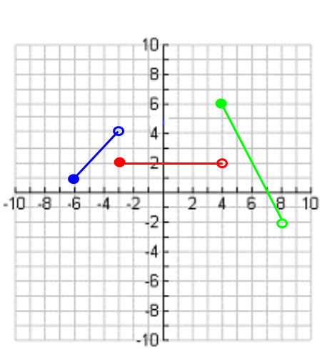
Writing equations
x f(x)
Graph the absolute value function.
List all transformations compared to the parent function.
Write the absolute value function as a piecewise function.
f(x) = -⎥ x + 2 ⎥
Write the equations of the lines that contain each segment.
  Left segment equation
  Middle equation
  Right equation
  List the domain of each segment.
  Left segment equation
  Middle equation
  Right equation
  Put the domain together with the
  equations to write the equation for
  the piecewise function.
Writing equations
©2010, Dr. Jennifer L. Bell, LaGrange High School, LaGrange, Georgia Adapted from Various Sources MCC9-12.F.IF.7b

Slide 6
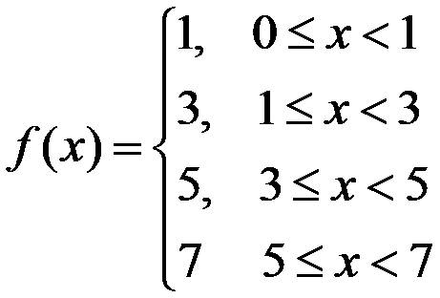

Step Functions
Graph the step function.
What is the domain?
What is the range?
Why is the range not all real numbers?
A _________ function is a piecewise function that consists of different constant range values for different intervals of the function’s domain.
3
2
Greatest integer function
1
Rounding-down function
-1
1
2
3
-3
-2
-1
-2
-3
Step Functions
©2010, Dr. Jennifer L. Bell, LaGrange High School, LaGrange, Georgia Adapted from Various Sources MCC9-12.F.IF.7b

Slide 7
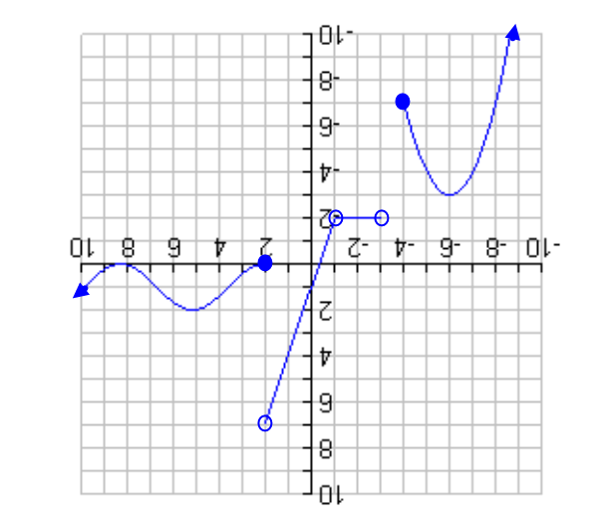
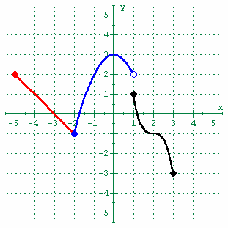
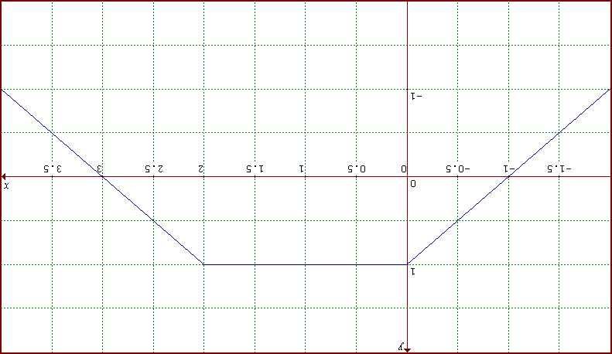
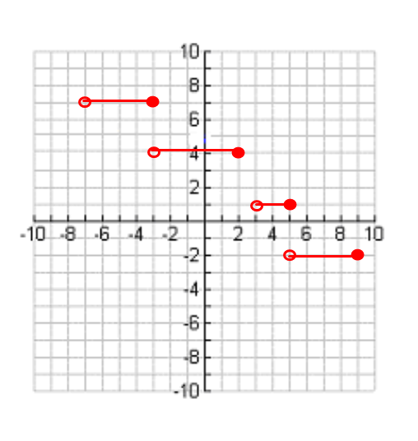
C
B
A
PRACTICE Use the following piecewise functions to answer the following questions:
What is the domain? Range?.
What are the x-intercepts? y-intercepts?
Describe the end behavior.
Where are the intervals of increasing? Decreasing? Remaining constant?
Find f(2).
Write the equation of the piecewise function that matches the step function graph.
Step Functions
©2010, Dr. Jennifer L. Bell, LaGrange High School, LaGrange, Georgia Adapted from Various Sources MCC9-12.F.IF.7b

