Slide 1
How are a function and its inverse related?
© 2010, Dr. Jennifer L. Bell, LaGrange High School, LaGrange, Georgia
(MCC9-12.F.BF.4; MCC9-12.F.BF.4a; MCC9-12.F.BF.4c; MCC9-12.F.BF.5)

Slide 2
Complete the following steps using f(x) = .
x – 3
2
Choose values for x.
Find the values for y.
Plot the points.
Draw a line that passes through them.

Slide 3
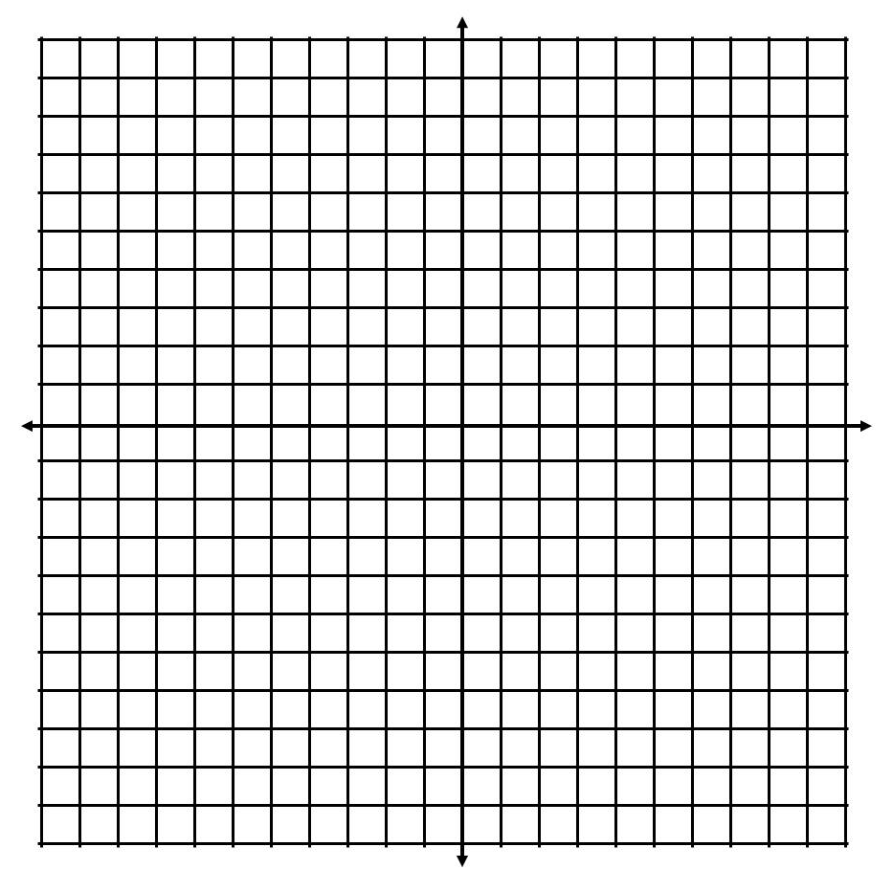
x – 3
2
f(x) =
x | y
-1
-2
1
-1
3
0

Slide 4
Complete the following steps using f(x) = .
x – 3
2
Switch the x and y.
Plot the points.
Draw a line that passes through them.

Slide 5
x – 3
2
f(x) =
x | y
-2
-1
-1
-2
-1
1
-1
1
3
0
3
0

Slide 6
Fold your graph paper so the 2 lines coincide.
symmetrical across y = x

Slide 7
Write the equation for the inverse.
f ⁻¹(x) = 2x + 3

Slide 8
You try!!
1. g(x) = 2x + 5
2. h(x) = ^{x – 2}
⁵

Slide 9
Complete the following steps using f(x) = 2^{x} - 3.
Choose values for x.
Find the values for y.
Plot the points.
Draw a line that passes through them.

Slide 10
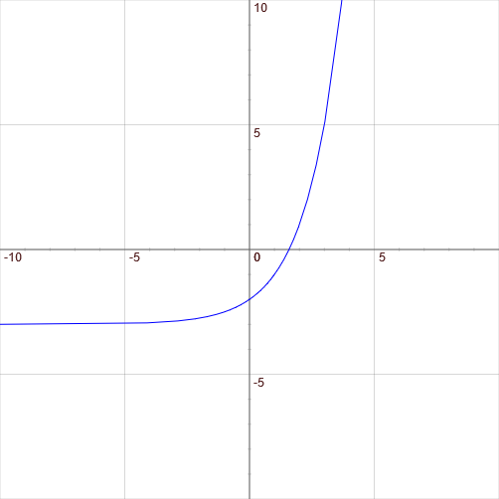
f(x) = 2^{x} - 3
x | y
0
-2
1
-1
2
1
3
5

Slide 11
Complete the following steps using f(x) = 2^{x} - 3.
Switch the x and y.
Plot the points.
Draw a line that passes through them.

Slide 12
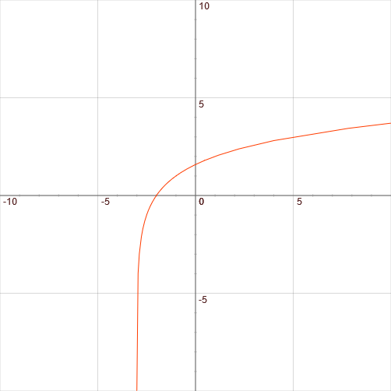
f(x) = 2^{x} - 3
x | y
-2
0
-2
0
-1
1
-1
1
2
1
1
2
3
5
3
5

Slide 13
Fold your graph paper so the 2 lines coincide.
symmetrical across y = x

Slide 14
Write the equation for the inverse.
f ⁻¹(x) = log₂(x+3)

