Slide 1
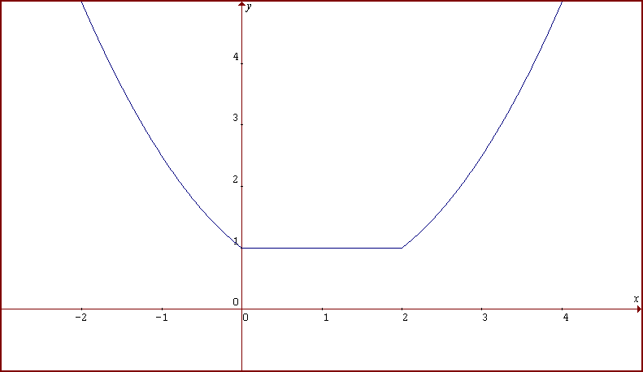
Intervals of Increasing and Decreasing
f(x) is decreasing from (-∞, 0]
downhill (“Wee!”)
f(x) is increasing from [2, ∞)
uphill (“Keep pedaling!”)
f(x) is remaining constant from [0, 2]
“It is time to take a break!”
©2010, Dr. Jennifer L. Bell, LaGrange High School, LaGrange, Georgia adapted from various sources (MCC9‐12.F.IF.4; MCC9‐12.F.IF.7)
Notes:
This is a piecewise function

