Slide 1

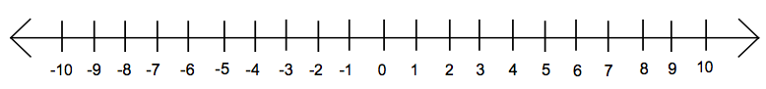
How to solve quadratic inequalities
Solve like a quadratic equation
greater than
means OR
(no overlap; nothing in common)
← →
> (open circle)
≥ (closed circle)
less than
means AND
(all solutions in common)
→ ←
< (open circle)
≤ (closed circle)
greater than
gap
© 2009, Dr. Jennifer L. Bell, LaGrange High School, LaGrange, Georgia (MCC9‐12.A.CED.1; MCC9‐12.A.REI.4b)
less than
sandwich
Example 1:
x² -7x + 10 ≥ 0
(x-2)(x-5) = 0
x = 2 x = 5
x ≤ 2 or x ≥ 5
Example 2:
x² -7x + 10 < 0
(x-2)(x-5) = 0
x = 2 x = 5
2 < x < 5

Slide 2
How to solve quadratic inequalities
Solve like a quadratic equation
____________
means OR
(no overlap; nothing in common)
← →
> (______ circle)
≥ (______ circle)
____________means AND
(all solutions in common)
→ ←
< (______ circle)
≤ (______ circle)
greater than
gap
© 2009, Dr. Jennifer L. Bell, LaGrange High School, LaGrange, Georgia (MCC9‐12.A.CED.1; MCC9‐12.A.REI.4b)
less than
sandwich
Example 1:
x² -7x + 10 ≥ 0
Example 2:
x² -7x + 10 < 0

