Slide 1
Teacher Preparation Directions
Gather materials: electrical tape, cut coordinate cards for number of students, & piece of rope.
Create a 20 by 20 coordinate grid on the classroom floor with electrical tape.
Select 2 students to be “Mike” and “Ike”.

Slide 2
(1, 16)
(5, 12)
(3, 5)
(10, 2)
(4, 9)
(9, 7)
(2, 18)
(11, 13)
(8, 11)
(12, 19)
(13, 6)
(0, 20)
(6, 13)
(7, 11)
(14, 10)
(15, 1)

Slide 3
(16, 8)
(17, 10)
(18, 5)
(9, 2)
(2, 13)
(2, 3)
(1, 8)
(1, 18)
(18, 20)
(12, 6)
(13, 12)
(19, 7)
(8, 16)
(9, 15)
(1, 14)
(5, 11)

Slide 4
How the Line of Best Fit Came to Be
Original Sources: Will Hadden & Bentley Wright
Modified by Dr. Jennifer L. Bell
© 2010, LaGrange High School, LaGrange, Georgia
(MCC.9-12.S.ID.6; MCC.9-12.S.ID.6a; MCC.9-12.S.ID.6b;
MCC.9-12.S.ID.6c; MCC.9-12.S.ID.7; MCC9-12.S.ID.8)

Slide 5
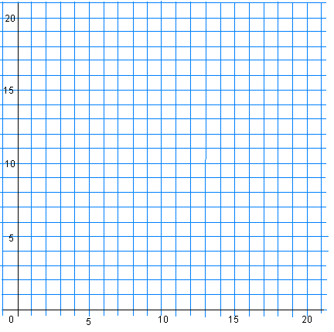
Once upon a time, there was a graph with lots of points on it.
Move to the location listed on your coordinate card.

Slide 6


Two of these points were brothers named Mike and Ike. They were both exceptionally smart cookies.
Mike’s coordinates are (15, 9).
Ike’s coordinates are (3, 12).

Slide 7
One day, all of the points were instructed to draw a line through the points, or the students who were working on the graph would get a F.
What is the problem?

Slide 8
The students discovered that the assigned task was impossible.

Slide 9
Mike and Ike had an idea.
Stretch a rope between Mike and Ike.

Slide 10
After stretching a rope between the points, the students went on to earn an A!

Slide 11
Later on, Mike and Ike decided to call their creation “line of best fit” because it fit between only a few of the points.

Slide 12
The End

Slide 13
Questions
1. What is the slope of the line?
-¹/₄
2. Where would the y-intercept be located?
≈13
3. What is the equation of the line?
y = -¹/₄x + 13
4. Describe the relationship between the points.
weak & negative
r ≈-0.29

Slide 14
Demonstrations
1. Show me a strong & positive relationship.
2. Show me a moderately strong, quadratic relationship.

