Slide 1
Graphing Radical Functions
©2014, Dr. Jennifer L. Brown, Columbus State University, Columbus, Georgia
(MCC9-12.F.IF.4; MCC9-12.F.IF.5; MCC9-12.F.IF.7b)

Slide 2


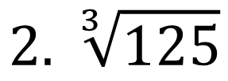

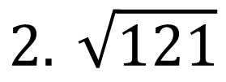
Evaluate.
36
11
$$1. 6^{2}$$
$$2. \sqrt{121}$$
$$3. 4^{3}$$
64
$$2. \sqrt[3]{125}$$
5

Slide 3
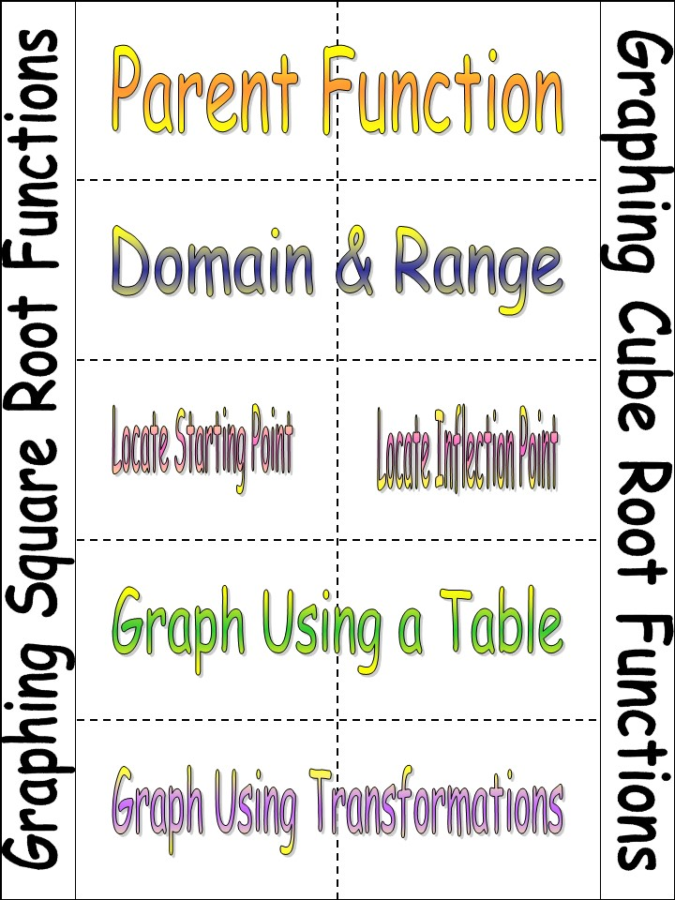
Directions
1. Cut along all dotted lines and the perimeter of the foldable.

Slide 4
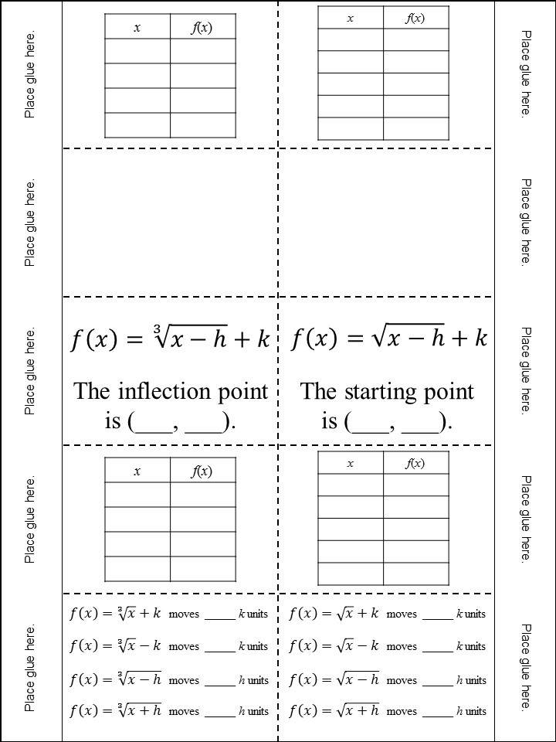
Directions
2. Place glue along the left and right sides as indicated.

Slide 5
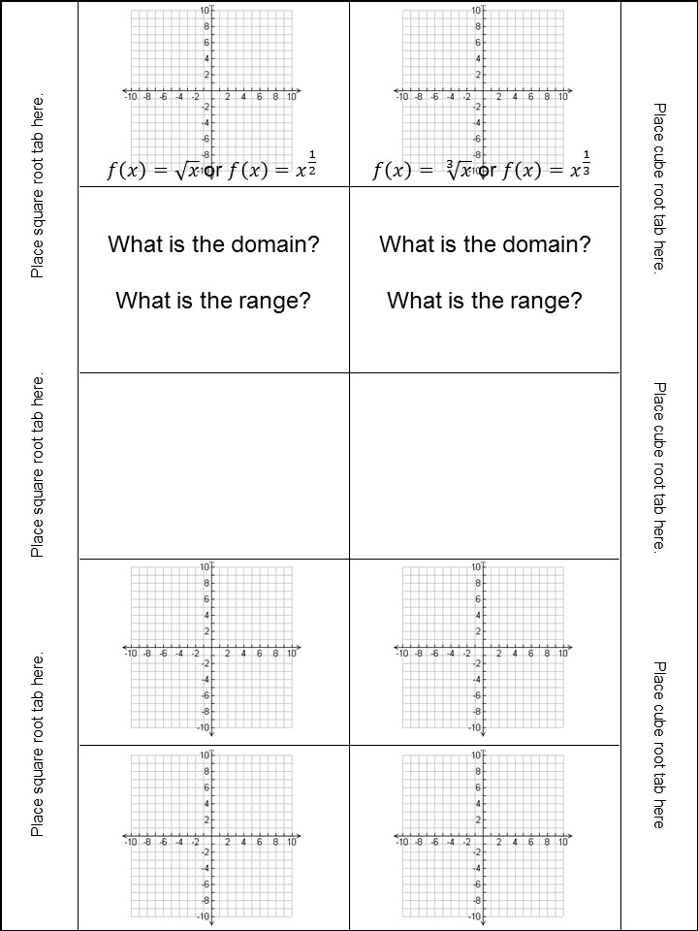
Directions
3. Place the two halves where indicated.

Slide 6
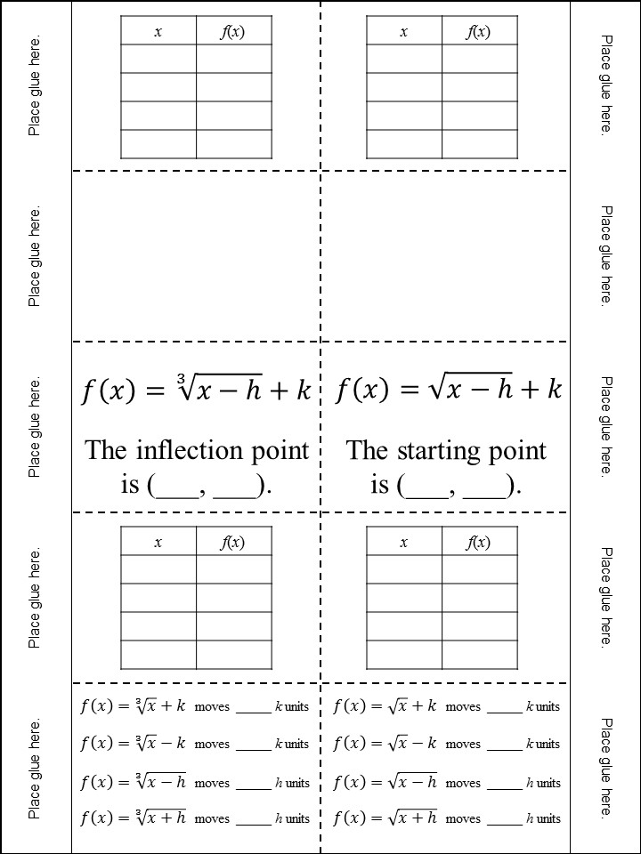

Slide 7
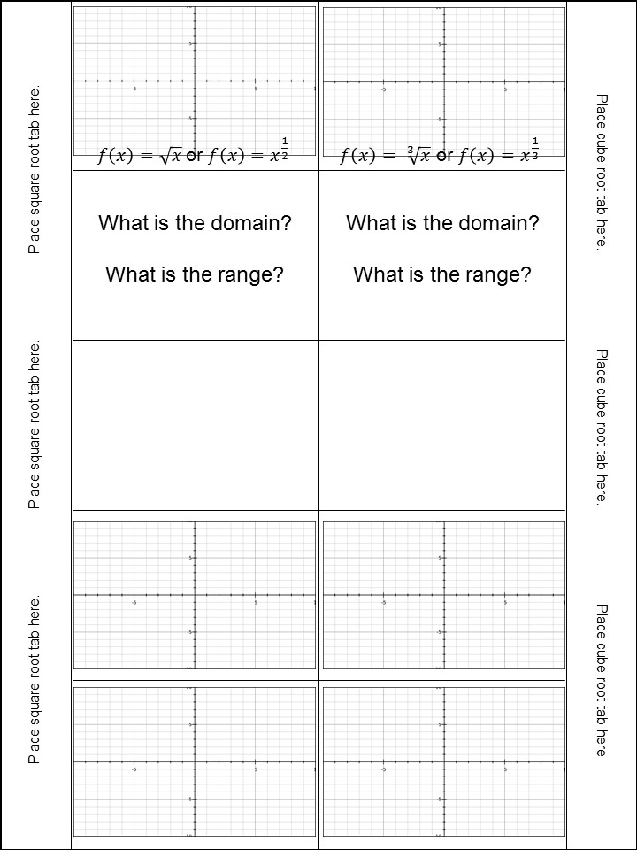
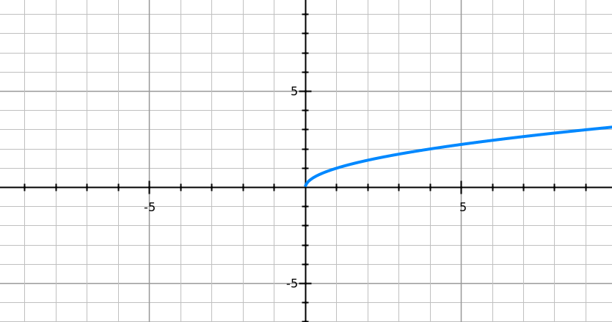
0
0
1
1
4
2
9
3

Slide 8
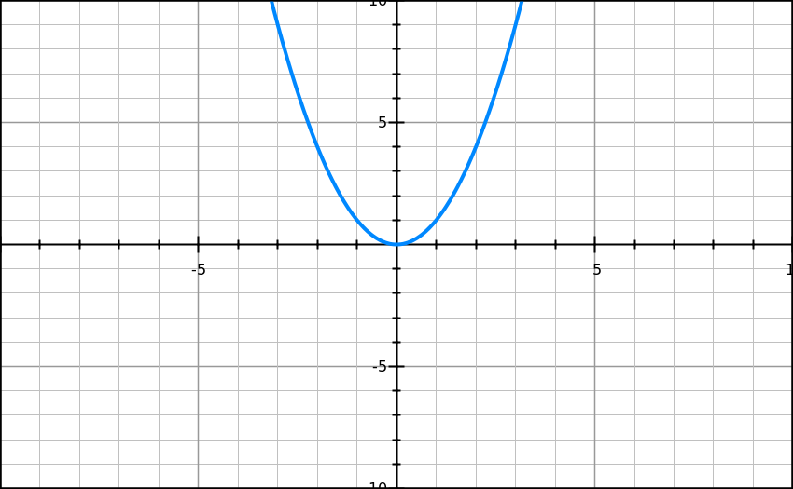
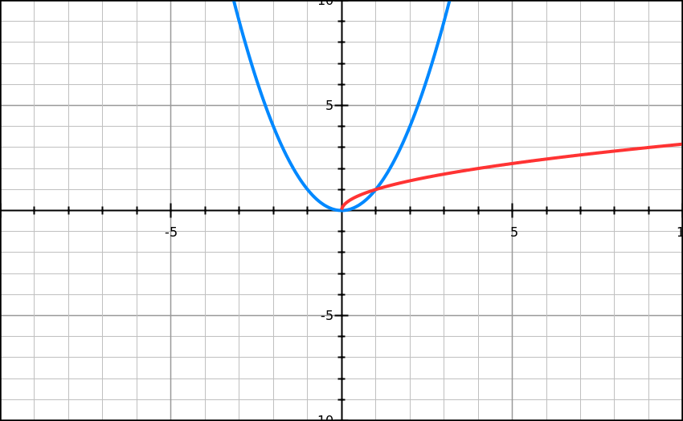

Describe the relationship between
f(x) = x² and f(x) $= \sqrt{x} .$
graphsketch.com

Slide 9
How are they similar?
How are they different?
graphsketch.com

Slide 10
[0, ∞) or x ≥ 0
[0, ∞) or y ≥ 0

Slide 11
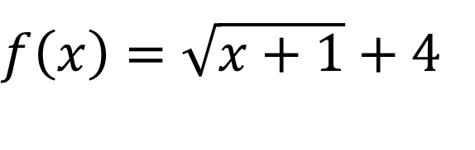



$$f\left(x\right)=\sqrt{x}$$
(0, 0)
$$f\left(x\right)=\sqrt{x−3}$$
(3, 0)
$f\left(x\right)=\sqrt{x}$ - 5
(0, -5)
h
k
$f\left(x\right)=\sqrt{x+1}$ + 4
(-1,
4)
- (-1)

Slide 12
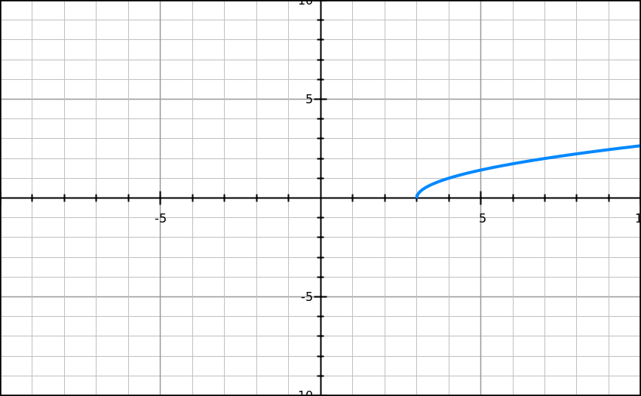

Begin with your starting point!
$$f\left(x\right)=\sqrt{x−3}$$
3
0
4
1
7
2
12
3
Plot your points, then connect them.

Slide 13
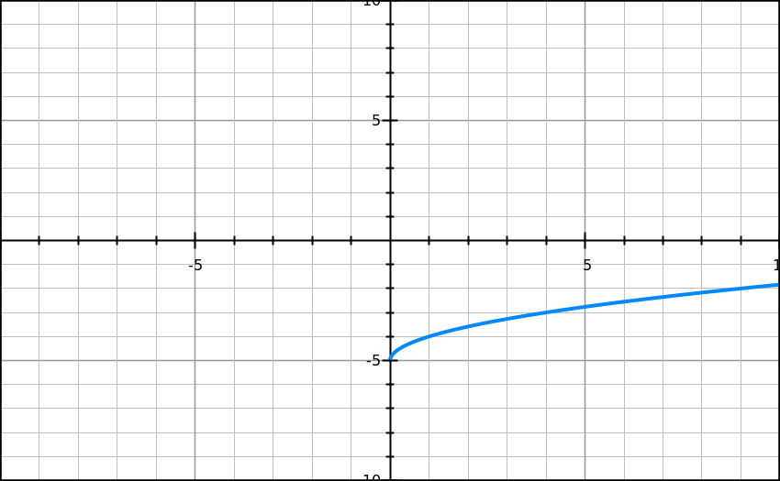
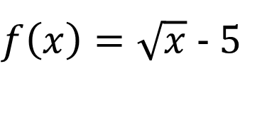
↑
$f\left(x\right)=\sqrt{x}$ - 5
↓
→
←

Slide 14
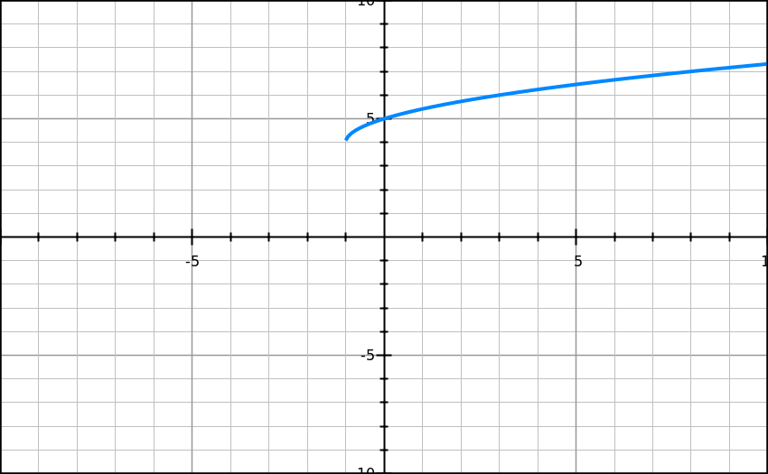
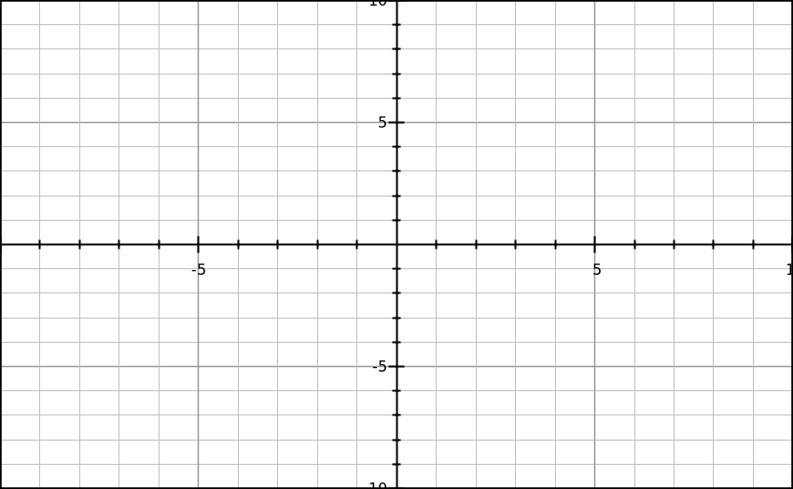
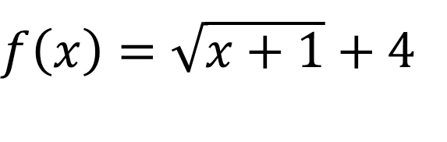
You try!
$f\left(x\right)=\sqrt{x+1}$ + 4
x | f(x)
↑ 4 units
-1
4
0
5
3
6
← 1 unit
8
7

Slide 16
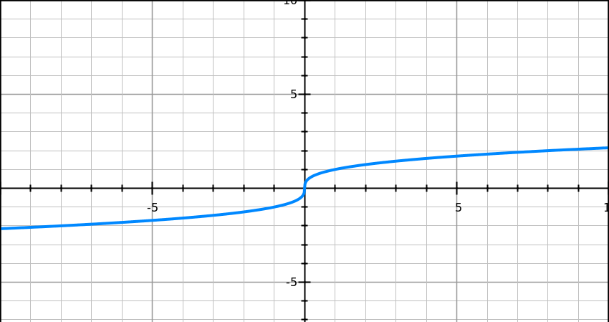
-8
-2
-1
-1
0
0
1
1
8
2

Slide 17
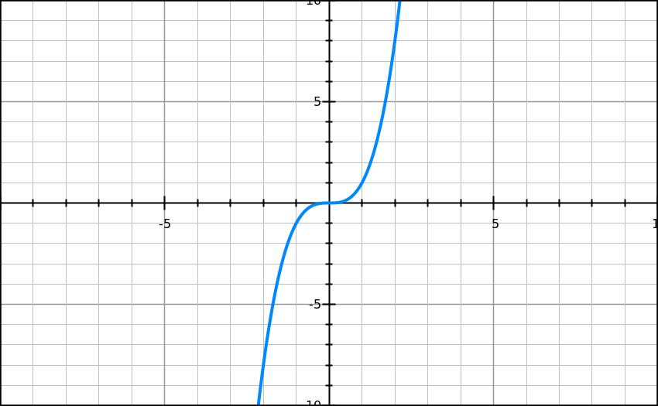
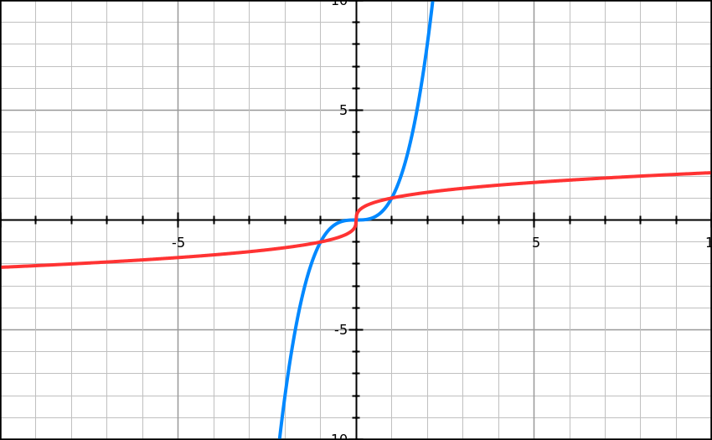

Describe the relationship between
f(x) = x³ and f(x) $= \sqrt[3]{x} .$
graphsketch.com

Slide 18
How are they similar?
How are they different?
graphsketch.com

Slide 19
(∞, ∞)
(∞, ∞)

Slide 20
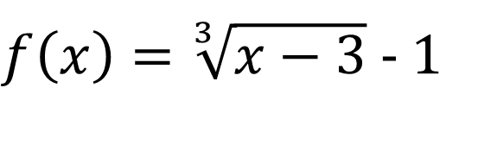



$$f\left(x\right)=\sqrt[3]{x}$$
(0, 0)
$$f\left(x\right)=\sqrt[3]{x+2}$$
(-2, 0)
- (-2)
$f\left(x\right)=\sqrt[3]{x}$ + 6
(0, 6)
h
k
$f\left(x\right)=\sqrt[3]{x−3}$ - 1
(3,
-1)

Slide 21
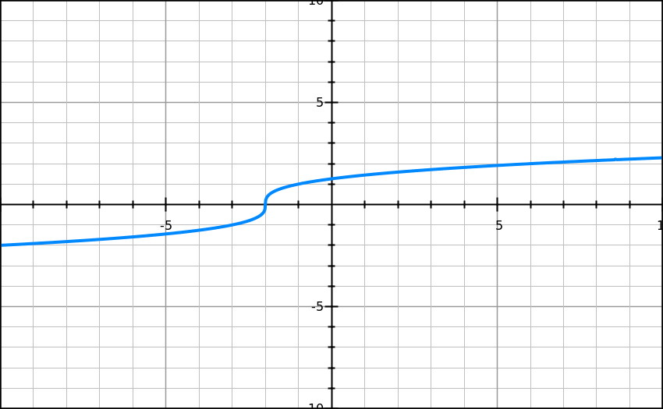

Begin with your starting point!
$$f\left(x\right)=\sqrt[3]{x+2}$$
-10
-2
-3
-1
-2
0
-1
1
6
2
Plot your points, then connect them.

Slide 22
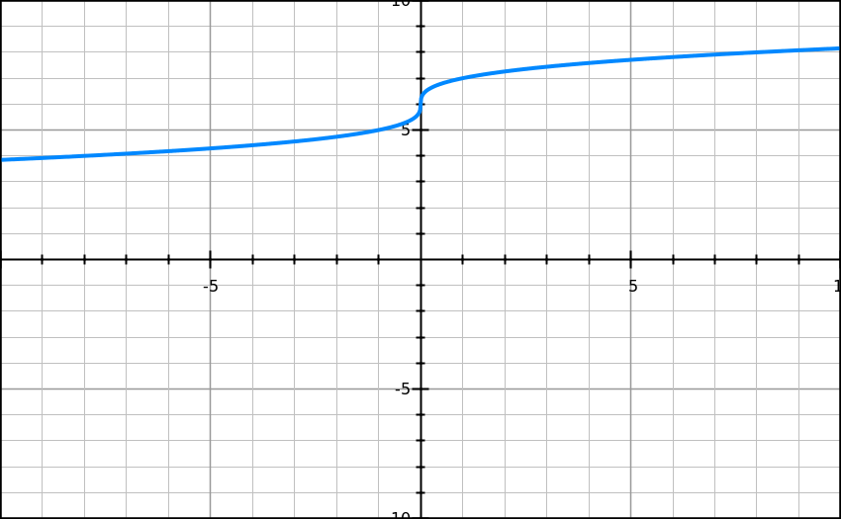

↑
$f\left(x\right)=\sqrt[3]{x}$ + 6
↓
→
←

Slide 23
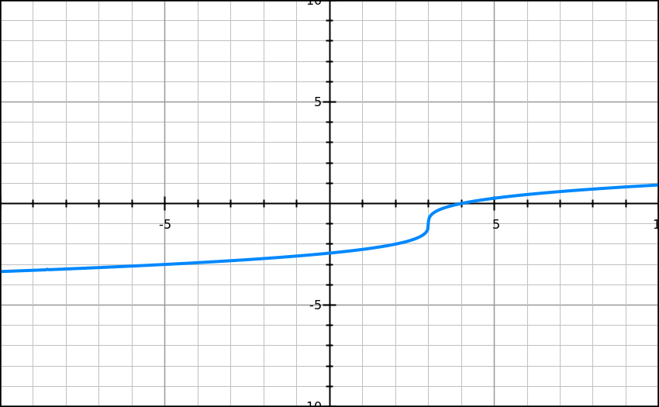
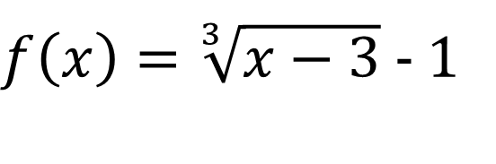
You try!
$f\left(x\right)=\sqrt[3]{x−3}$ - 1
x | f(x)
↓ 1 unit
-5
-3
2
-2
3
-1
→ 3 units
4
0
11
1

