Slide 1
Characteristics of
Quadratics Foldable
Dr. Jennifer L. Brown, © 2013,
Columbus State University,
CRMC Summer Workshop
(MCC9‐12.F.IF.4; MCC9‐12.F.IF.5; MCC9‐12.F.IF.6;
MCC9‐12.F.IF.7a; MCC9‐12.F.IF.8a)

Slide 2
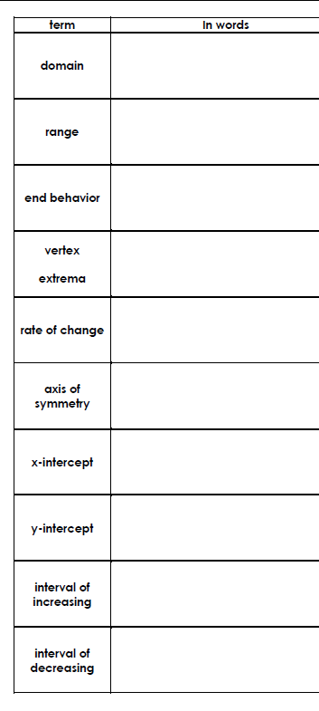
Directions
Fold hotdog style (lengthwise) as shown.

Slide 3
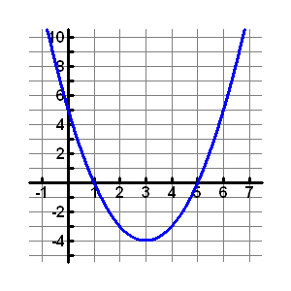
f(x) = x² – 6x + 5
all possible x-values
(-∞, ∞)
all possible y-values
[-4, ∞)

Slide 4
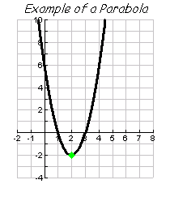
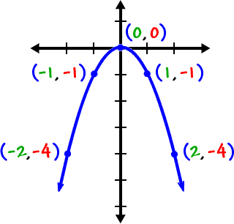
f(x) = 2x² – 8x + 6
What is happening at the end of the graph?
“rising” or “falling”
rising
rising
The lowest or highest point of a parabola.
(2, -2)
Minimum: lowest point
(bottom of the valley)
Maximum: highest point
(top of the mountain)

Slide 5
f(x) = 2x² – 8x + 6
⁻2 – 0
2 - 3
⁻2
⁻1
⁺
Slope of a line between two points.
=
⁺
(3, 0)
(2, -2)
A vertical line through the vertex…mirror image.
x = 2

Slide 6
f(x) = x² – 6x + 5
“zeros”; point(s) where the graph crosses
the x-axis
(1, 0)
& (5,0)
point where the graph crosses the y-axis
(0,5)

Slide 7
where the graph is going uphill… pressing the gas!
[3, ∞)
where the graph is going downhill…Whee!!
(-∞, 3]
f(x) = x² – 6x + 5

Slide 8
domain?
range?
end behavior?
vertex?
extrema?
rate of change?
axis of symmetry?
8. x-intercept(s)?
9. y-intercept?
10. interval of increasing?
11. interval of decreasing?
(-∞, ∞)
[3, ∞)
(-1, 11)
(3,11)
rising
x = 1
(1, 3)
minimum
x = 1
(0,5)
(2,5)
none
(0, 5)
(1,3)
[1, ∞)
(-∞, 1]

Slide 9
y = - ½ (x + 3)² + 4
domain?
range?
end behavior?
vertex?
extrema?
rate of change?
axis of symmetry?
7. x-intercept(s)?
8. y-intercept?
9. interval of increasing?
10. interval of decreasing?
x = 3

