Slide 1
Quadratics
In
Wil E. Coyote’s world
Dr. Jennifer L. Bell, © 2011,
LaGrange High School, LaGrange, Georgia
(MCC9‐12.A.REI.4b; MCC9‐12.F.IF.4;
MCC9‐12.F.IF.5; MCC9‐12.F.IF.7a)

Slide 3
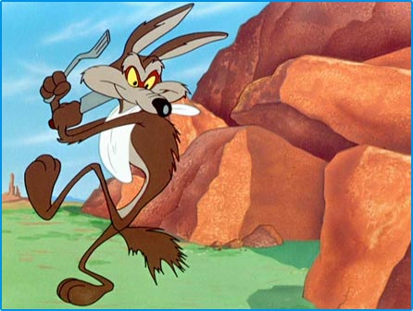
Wil E. Coyote is catapulting a boulder off a cliff to hit the road runner. Let t represent the number of seconds that the boulder catapults off the cliff and h(t) denote the height of the boulder, in feet, above the base of the cliff. Ignoring air resistance, we can use the following formula to express the path of the boulder: h(t) = -16t² + 24t + 160

Slide 4
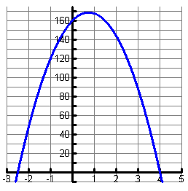
1. What part of the graph is insignificant? Why?

Slide 5
2. What was the height of the boulder before it was launched? What special point on the graph is associated with this information?

Slide 6
3. How long will it take before the boulder reaches the bottom of the cliff? What special point on the graph is associated with this information?

Slide 7
4. After how many seconds does the boulder change direction? How high is the boulder when it changes direction? What special point on the graph is associated with this information?

Slide 8
5. When will the boulder hit the ground?
h(t) = -16t² + 24t + 160
-8(2t² – 3t – 20)
2
x
-20
=
-40
=
2
x
-4
=
-8
x
1
x
5
=
5

Slide 9
t – 4 = 0
2t + 5 = 0
+ 4
+ 4
- 5
- 5
t = 4
2t = ⁻5
2
2
t = ⁻ 2.5

