Slide 1
The Wandering Point
Retrieved from stat.scareyjones.com Adapted by Dr. Jennifer L. Brown, Columbus State University, ©2012
(MCC9-12.S.ID.6; MCC9-12.S.ID.6a; MCC9-12.S.ID.6b; MCC9-12.S.ID.6c)

Slide 2
What is a residual?
difference between observed and predicted y values
How do you find the residual?
length of vertical line from predicted to observed.
y - ŷ

Slide 3
Procedures:
Use your wikki stick to “eyeball” a line of best fit.
Find ŷ (predicted y value) for each x value.
Find the informal residual for each x value.
Find y - ŷ (exact residual) for each x value.

Slide 4
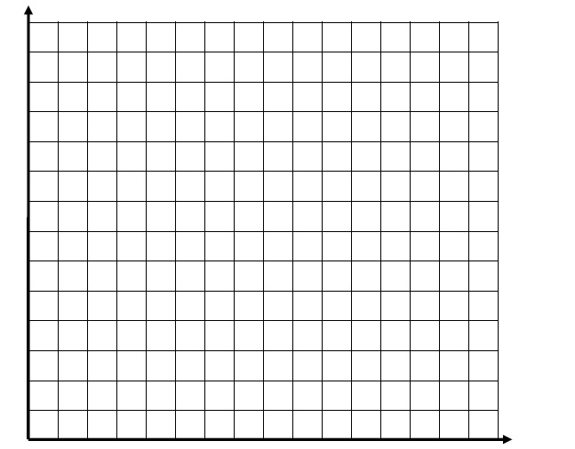
ŷ = 0.4x + 2.8
x | y
1 | 2
2 | 6
4 | 2
5 | 6
+
-
1.

Slide 5
ŷ = 0.4x + 2.8
x | y | ŷ | Informal Residual | y - ŷ
1 | 2 | 3.2 | -1 | -1.2
2 | 6 | 3.6 | 2.5 | 2.4
4 | 2 | 4.4 | -2.5 | -2.6
5 | 6 | 4.8 | 1.5 | 1.2

Slide 6
ŷ = 0.8x + 1.8
x | y
1 | 2
2 | 6
4 | 2
5 | 6
8 | 9
2.

Slide 7
ŷ = 0.8x + 1.8
x | y | ŷ | Informal Residual | y - ŷ
1 | 2 | 2.6 | -0.5 | -0.6
2 | 6 | 3.4 | 3.0 | 2.6
4 | 2 | 5 | -3.0 | -3.0
5 | 6 | 5.8 | 0.5 | 0.2
8 | 9 | 8.2 | 0.5 | 0.8

Slide 8
ŷ = 0.4x + 3.6
x | y
1 | 2
2 | 6
4 | 2
5 | 6
3 | 8
3.

Slide 9
ŷ = 0.4x + 3.6
x | y | ŷ | Informal Residual | y - ŷ
1 | 2 | 4 | -2.0 | -2.0
2 | 6 | 4.4 | 1.5 | 1.6
4 | 2 | 5.2 | -3.0 | -3.2
5 | 6 | 5.6 | 0.5 | 0.4
3 | 8 | 4.8 | 3.5 | 3.2

Slide 10
ŷ = -0.06x + 4.8
x | y
1 | 2
2 | 6
4 | 2
5 | 6
1 | 7
4.

Slide 11
ŷ = -0.06x + 4.8
x | y | ŷ | Informal Residual | y - ŷ
1 | 2 | 4.74 | -2.5 | -2.74
2 | 6 | 4.68 | 1.5 | 1.32
4 | 2 | 4.56 | -2.5 | -2.56
5 | 6 | 4.5 | 1.5 | 1.5
1 | 7 | 4.74 | 2.5 | 2.26

Slide 12
Extension Activity
Purpose:
To determine the influence of one more point on the correlation and the slope.
MCC9-12.S.ID.7; MCC9-12.S.ID.8)

Slide 13
Fifth Point | Correlation | Slope of the regression line | Size of the residual
None | 0.3162 | 0.4 | N/A
(3,4) | 0.3162 | 0.4 | 0
(8,6) | 0.5 | 0.4 | 0
(10,7) | 0.6157 | 0.4228 | 0.033 (small)
(3,8) | 0.2357 | 0.4 | 3.2 (large)
(1,7) | -0.0457 | -0.06 | 2.3 (medium)
(8,9) | 0.7303 | 0.8 | 0.8 (small)
(10,0) | -0.4888 | -0.3740 | -1.1 (small)

Slide 14
Residual Plot
Purpose: Determine if a linear model is an appropriate fit for the data.
(MCC9-12.S.ID.6; MCC9-12.S.ID.6a; MCC9-12.S.ID.6b; MCC9-12.S.ID.6c)

Slide 15
Graph the x values and the residual values.
ŷ = 0.4x + 2.8

Slide 16
Linear or Non-linear?

Slide 17
Templates/Handouts

Slide 18
x | y
1 | 2
2 | 6
4 | 2
5 | 6

Slide 19
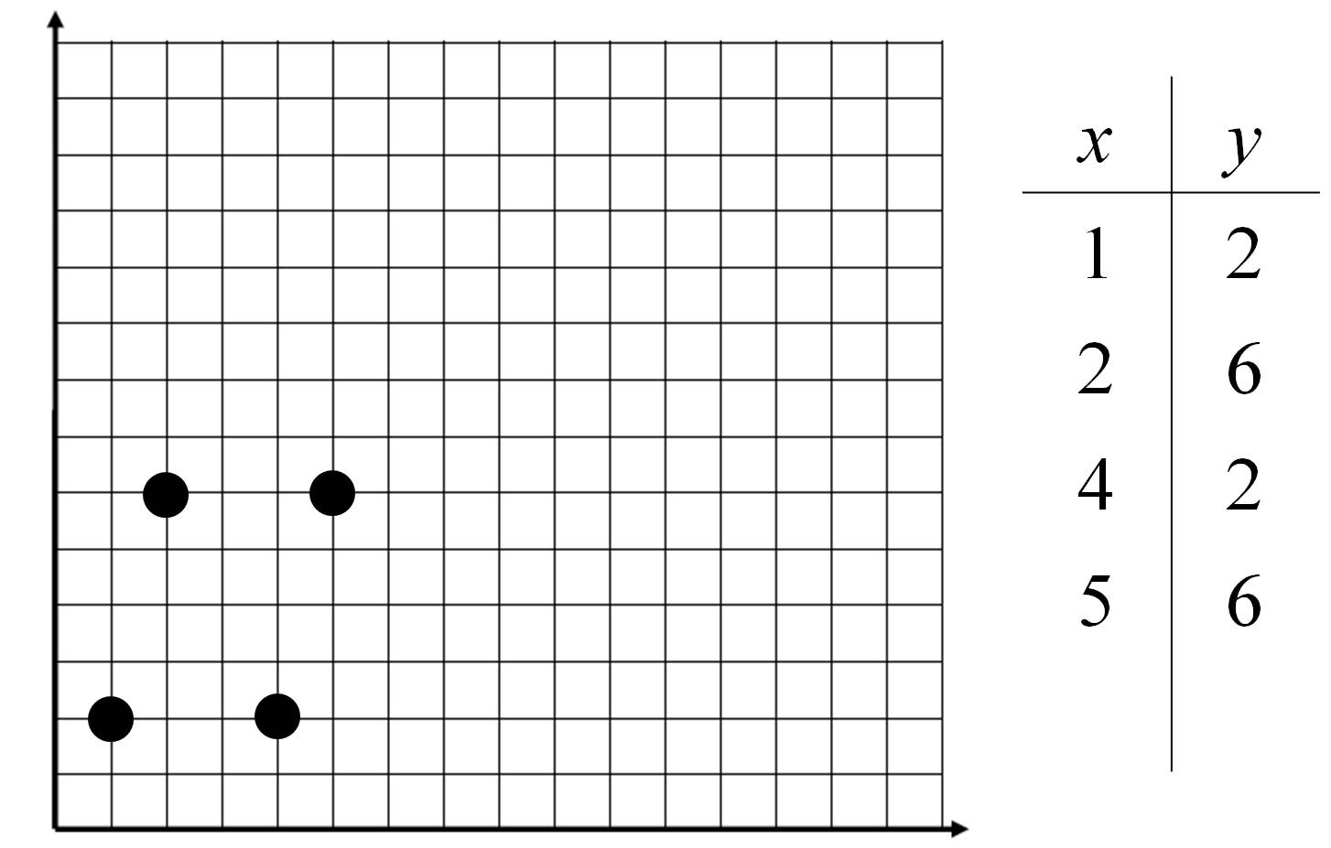

Slide 20
1.
2.
x | y | ŷ | Informal Residual | y - ŷ
1 | 2
2 | 6
4 | 2
5 | 6
x | y | ŷ | Informal Residual | y - ŷ
1 | 2
2 | 6
4 | 2
5 | 6
3.
4.
x | y | ŷ | Informal Residual | y - ŷ
1 | 2
2 | 6
4 | 2
5 | 6
x | y | ŷ | Informal Residual | y - ŷ
1 | 2
2 | 6
4 | 2
5 | 6

