Slide 1
The Great
Number-Letter War
And the story of little i
MCC9-12.N.CN.1; MCC9-12.N.CN.2; MCC9-12.N.CN.3

Slide 2
Chapter one:
Simplifying

Slide 3
Many years ago, the numbers and letter went to war. Due to their infinite amount of troops, the numbers quickly began raiding the letter camps and captured many letter prisoners. After many fierce battles, the surrounding communities began to call for peace.

Slide 4

A negotiator was brought into bring an end to this Great Number-Letter War. The Number One represented the numbers while Capital A represented the letters. After much negotiation, a compromise was reached!

Slide 5
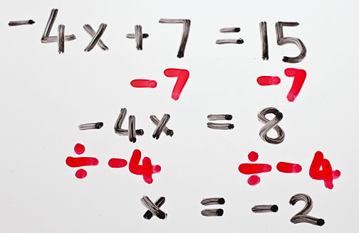
The letters wanted their captured friends returned, but the numbers had already put the letters to work as variables. An agreement was reached. The numbers could borrow the letters in their math equations as long as the letters got to return home to their families.

Slide 6
Finally, the big day for the letters to return home arrived. All of the letters, especially Little x, who seemed to be the most frequently used variable, were ready to return home. As the letters lined up, Number One noticed Little i in the corner crying.
I want to stay with the numbers!
What’s the matter, Little i?

Slide 7

Number One, Capital A, and Capital B quickly came together to discuss the situation. A suggestion was made. If the numbers would adopt Little i and treat him just like any other number, then he could stay. Little i was so happy!

Slide 8
A few weeks later, Little i went to Number One and asked for a number of his very own. Number One thought and thought. Zero had already taken the position of gatekeeper between the positive and negative integers. The integers had named themselves from negative infinity to positive infinity. Fractions and decimals had represented every possible number in between the integers in an attempt to separate the rationale and irrational cities.

Slide 9
Suddenly, Number One had an idea!
I will create a brand new number for you, Little i.
You will be a very unique number that has never been seen before!
You promised to adopt me and make me a number, too!
What number? What number?
Little i was thrilled!

Slide 10

Little i was very proud of his number and went around the town showing off his value.
You will be ! You will be called our imaginary number since people will forever have to imagine your existence.

Slide 11
A few jealous numbers began to tease Little i.
You can’t even be graphed!
You can’t do operations like us!
No one will ever use you!

Slide 12
Little i went back to Number One.
Of course not! We simply need to teach you your rules.
Is this true, Number One?
So, the training of Little i began!

Slide 13
imaginary unit:
standard form: a + bi
**Real numbers always go first!!
1.
Make the negative sign positive.
2.
Add an "i" in front of the radical sign.
3.
Make a tree to clean up the "jailhouse".

Slide 14
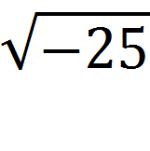
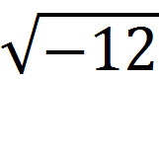
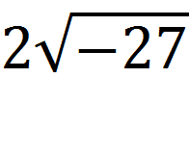
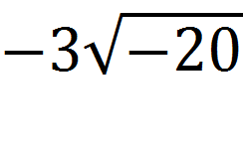
Examples
1.
2.
3.
4.

Slide 15
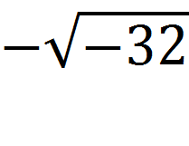
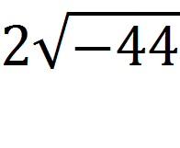
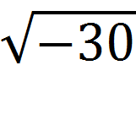
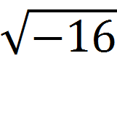
You try!!
1.
2.
3.
4.

Slide 16
Chapter Two:
Adding & Subtracting

Slide 17


The first thing that the numbers taught Little i was how to add and subtract.
+ + + + = 5
Or…
3 + 4 = 7
Little i, you have to think of it as counting oranges or tickets.
Do you mean like this?

Slide 18

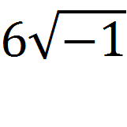
Little i said, “i + i + i + i + i + i is the same as ,
which simplifies to 6i or .”
The numbers were very proud because Little i caught on so quickly!

Slide 19
Combine like terms!
Simplify first!
Every little kid gets the negative when subtracting!

Slide 20
Examples
1.
2.

Slide 21
More Examples
3. (-10 + 6i) - (8 + i)
4. (9 + 2i) – (3 – 4i)

Slide 22
You try!!
1.
2.
3.

Slide 23
Chapter Three:
Multiplying

Slide 24

Little i was soon ready to learn multiplication. Number One got the radical family, which knew some special rules, to teach Little i how to multiply.
Now, Little i, you have to be careful since you have a negative number underneath your radical sign. Watch me and my friends for a minute.

Slide 25
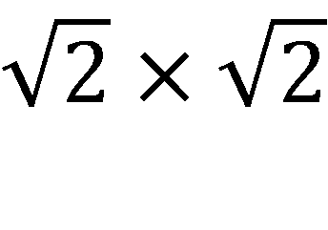
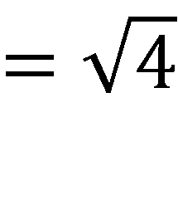
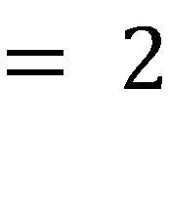
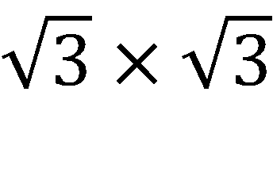
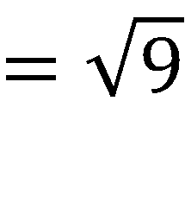
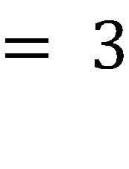
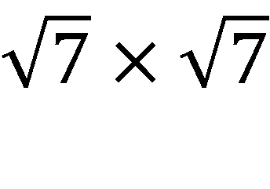
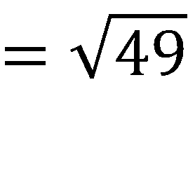
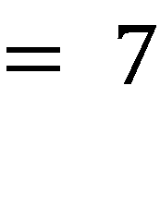

Slide 26
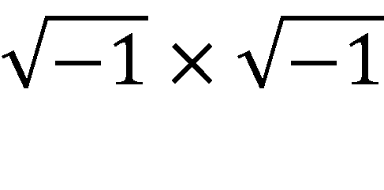
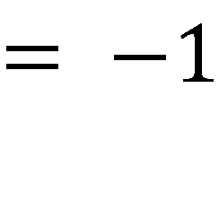
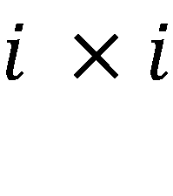
Little i was timid, but he decided to try.
You can’t follow our rule exactly because ⁻1 * ⁻1 is ⁺1; however, your final answer will be similar to ours.
Do you mean like this?

Slide 27
Wow, you are a smart cookie! What do you think 3i * 4i would be?
Very good! Are you ready for some harder problems?
No, but you are on the right track.
Try again!
Correct! Now, what is i * i?
Hmmmm, that is hard! Is it 12i?
Well, I know
3 * 4 is 12.
⁻1 so 3i * 4i = 12 * ⁻1 = ⁻12!

Slide 28
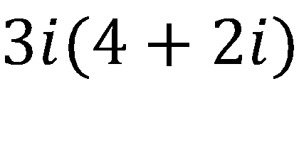
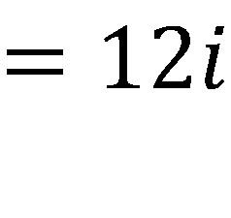
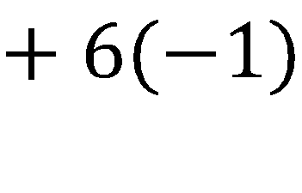
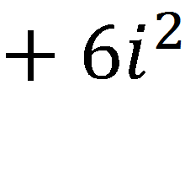
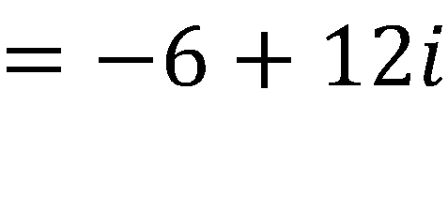
Excellent, Little i!
Okay, try this one!
You have to leave them apart, 12i – 6, but people like to save the best for last and write it as ⁻6 + 12i.
Well, I know that I have to distribute.
The i² is the same as ⁻1.

Slide 29
1. Simplify.
*Bring out the i.
2. Multiply.
*Distributive Property
*FOIL or Boxing Method
3. Write in
a + bi form.

Slide 30
Examples
1.
2. 4i (5 + 2i)
3. (3 + 4i)(2 – 3i)
4.

Slide 31
You try!!
1.
2.
3.
4.
5.

Slide 32
Chapter Four:
Complex Conjugates

Slide 33
After a few more days, Little i was ready for division. He went back to the radical family to get a little help.
Wait a minute! You need to do a little work before tackling division.
Show me fast, please. I know that I am ready!
Little i was frustrated because he wanted to do everything just like all of the other numbers.

Slide 34
Square Root of 2 smiled.
Remember that you are special. Always remember what happens when you multiply …

Slide 35
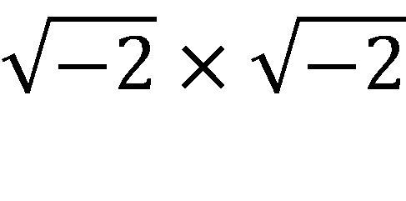
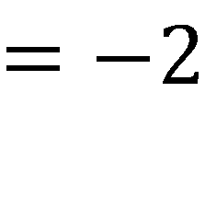
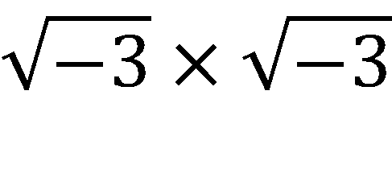
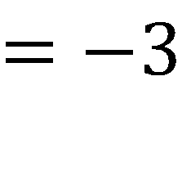
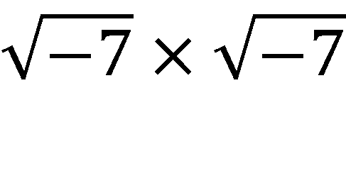
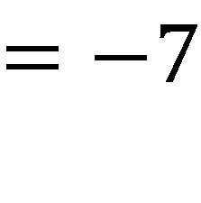

Slide 36
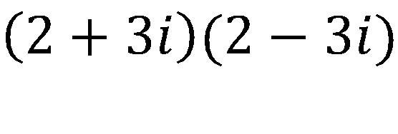
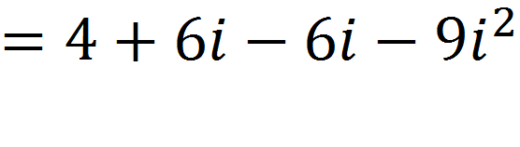
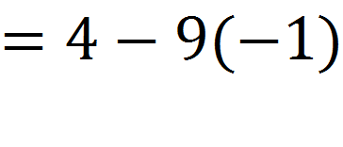
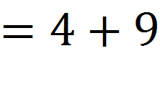
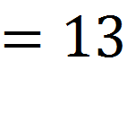

Slide 37
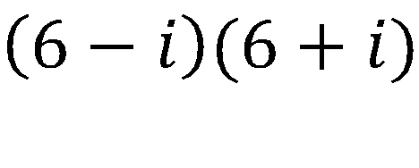
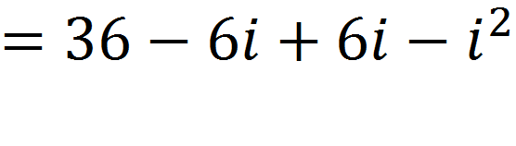
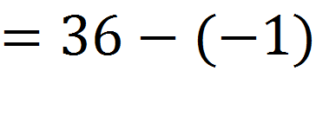
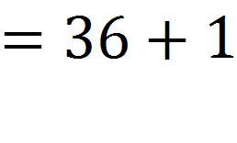
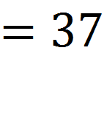

Slide 38
The last two examples are called conjugates. They are needed when dividing.
Little i started to see the pattern.

Slide 39
Examples
Multiply each expression by its conjugate.
2 + 7i
3 – 8i
6 – 2i
1 + 4i

Slide 40
Chapter Five:
Dividing

Slide 41

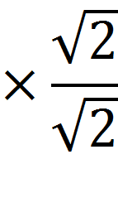
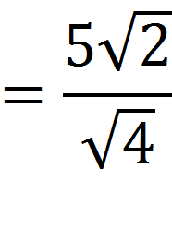
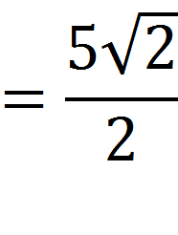
Now, I can show you why the conjugate is important. You see, Little i, special numbers like us are never allowed to stay in the denominator.
The process is called rationalizing the denominator.
We must use multiplication to move us out!

Slide 42


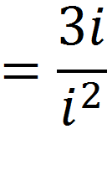
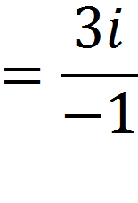
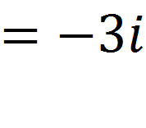
Let’s try another example.

Slide 43
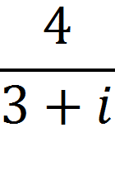





Let’s try one more.

Slide 44
1. Write the division as a fraction.
2. Multiply (FOIL) the numerator & denominator by the complex conjugate of the denominator.
3. Replace i² with -1.
5. Write the answer in a+bi form.
4. Combine like terms.

Slide 45
Another Example
(3 – 2i)
(-4 – i)
=
(-4 + i)
(-4 - i)
-12
- 3i
+ 8i
+ 2i²
=
16
+ 4i
- 4i
- i²
-12
+ 5i
+ 2(-1)
-14
+ 5i
=
=
16
- (-1)
17

Slide 46
One More Example

Slide 47
You try!!
1.
2.
3.
4.

Slide 48
Adapted by Dr. Jennifer L. Brown, Columbus State University, ©2013.
Original source created
by Nicole Spiller.

