Slide 1
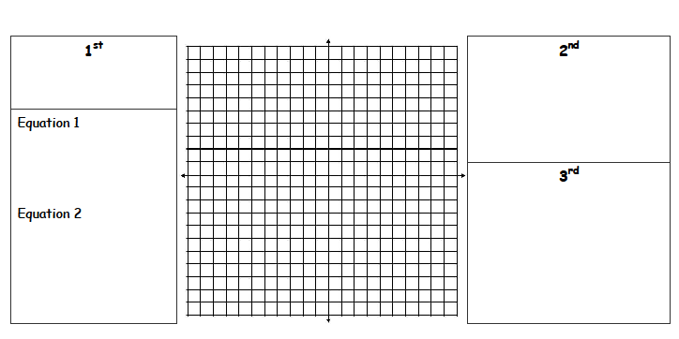
Solving a System of Equations
by Graphing
8
Put the equations in _______________
form.
6
__________ the
equations.
4
x + y = 2
2
-8
-6
-4
-2
2
4
6
8
-2
Locate the
_____________.
x = y
-4
-6
-8
© 2009, Dr. Jennifer L. Bell, LaGrange High School, LaGrange, Georgia Adapted from various sources
(MCC9-12.A.REI.1; MCC9-12.A.REI.3; MCC9-12.A.REI.5; MCC9-12.A.REI.6; MCC9-12.A.REI.12; MCC9-12.A.REI.11)

Slide 2
Solving a System of Equations
by Graphing
8
Put the equations in slope-intercept
form.
6
Graph the
equations.
4
x + y = 2
2
y = - x + 2
-8
-6
-4
-2
2
4
6
8
-2
Locate the
intersection.
x = y
-4
y = x
-6
(1,1)
-8
© 2009, Dr. Jennifer L. Bell, LaGrange High School, LaGrange, Georgia Adapted from various sources
(MCC9-12.A.REI.1; MCC9-12.A.REI.3; MCC9-12.A.REI.5; MCC9-12.A.REI.6; MCC9-12.A.REI.12; MCC9-12.A.REI.11)

