Slide 1
The Deltry Paper Airplane
www.bestpaperairplanes.com
(MCC9‐12.G.SRT.6; MCC9‐12.G.SRT.7; MCC9‐12.G.SRT.8)
©2009, Dr. Jennifer L. Bell, LaGrange High School, LaGrange, Georgia Original Lesson from Nancy Powell, Bloomington High School, Bloomington, Indiana

Slide 2
Guidelines
The plane must be folded from a single piece of 8½ x 11" paper.
No cutting of the paper is allowed.
No weights may added.
No glue or tape may be used.
©2009, Dr. Jennifer L. Bell, LaGrange High School, LaGrange, Georgia Original Lesson from Nancy Powell, Bloomington High School, Bloomington, Indiana

Slide 3
Rules
Do not fly the airplanes until instructed.
Follow all school and classroom rules.
©2009, Dr. Jennifer L. Bell, LaGrange High School, LaGrange, Georgia Original Lesson from Nancy Powell, Bloomington High School, Bloomington, Indiana

Slide 4
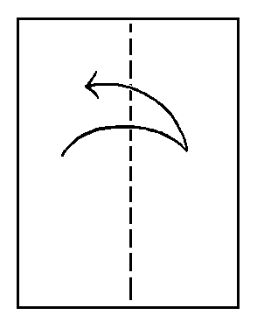
Step 1:
Take an 8½ by 11” sheet
of paper, fold it in half
lengthwise, & unfold it.
The dashed line
represents the “valley fold,” and the dashed-and-dotted line represents the "mountain fold.”
©2009, Dr. Jennifer L. Bell, LaGrange High School, LaGrange, Georgia Original Lesson from Nancy Powell, Bloomington High School, Bloomington, Indiana

Slide 5
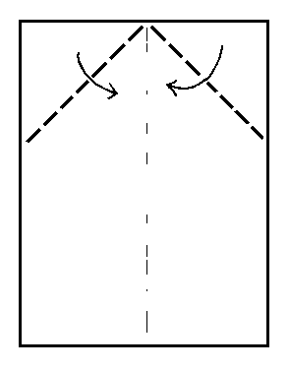
Step 2:
Fold down the top
corners inward
to the center crease.
©2009, Dr. Jennifer L. Bell, LaGrange High School, LaGrange, Georgia Original Lesson from Nancy Powell, Bloomington High School, Bloomington, Indiana

Slide 6
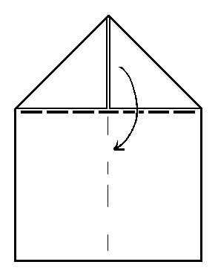
Step 3:
Fold down the
large top triangle,
made up of the two
small triangles you
created in step 2.
©2009, Dr. Jennifer L. Bell, LaGrange High School, LaGrange, Georgia Original Lesson from Nancy Powell, Bloomington High School, Bloomington, Indiana

Slide 7
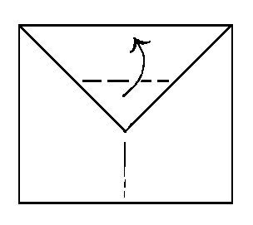
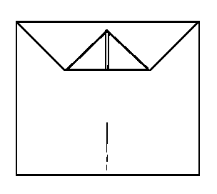
Step 4:
Fold the lower part of the large triangle up again. Leave about ³/₈” from the top.
It will help the flaps to lock under tightly & keep the airplane together
when it's finished.
©2009, Dr. Jennifer L. Bell, LaGrange High School, LaGrange, Georgia Original Lesson from Nancy Powell, Bloomington High School, Bloomington, Indiana

Slide 8
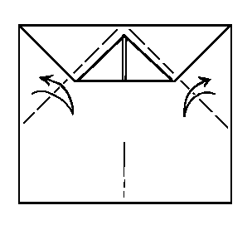
Step 5:
Fold and unfold two top triangles,
where the dashed valley folds
are shown. As in step 2, the inner edges of the new triangles should line up with the center line of the plane.
Don't try to fold right up
against the tip you folded up in step 4,
since that tip should be a little lower.
©2009, Dr. Jennifer L. Bell, LaGrange High School, LaGrange, Georgia Original Lesson from Nancy Powell, Bloomington High School, Bloomington, Indiana

Slide 9
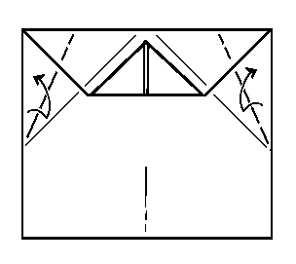
Step 6:
Bisect the new folds that you made in step 5, using the previous creases as a guide. Fold and then unfold
along the two dashed lines.
You back where you started, but you have created two new upper creases.
©2009, Dr. Jennifer L. Bell, LaGrange High School, LaGrange, Georgia Original Lesson from Nancy Powell, Bloomington High School, Bloomington, Indiana

Slide 10
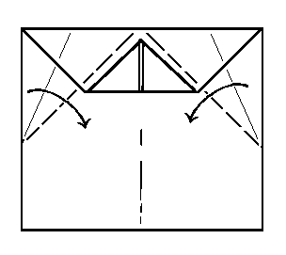
Step 7:
Fold the two large right
angle triangles down again, repeating the first part of step 5.
For the moment, ignore the two new creases
you just created in step 5 .
©2009, Dr. Jennifer L. Bell, LaGrange High School, LaGrange, Georgia Original Lesson from Nancy Powell, Bloomington High School, Bloomington, Indiana

Slide 11
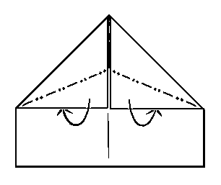
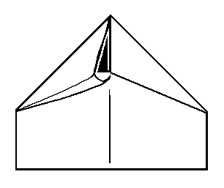
Step 8:
Fold along the two dotted-and-dashed
"mountain folds“. Tuck the lower triangles well underneath and snugly lock them in place. (These two triangles of paper go underneath the tip you folded up in step 4.)
©2009, Dr. Jennifer L. Bell, LaGrange High School, LaGrange, Georgia Original Lesson from Nancy Powell, Bloomington High School, Bloomington, Indiana

Slide 12
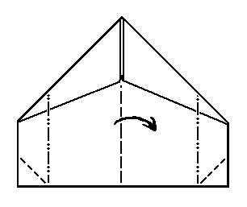
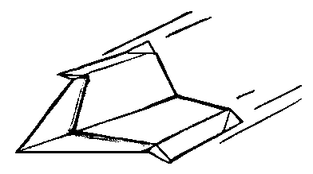
Step 9:
Make a few partial folds. Be sure to distinguish the dashed "valley folds" that create a valley from the dashed-and-dotted "mountain folds" that
create slight hills.
©2009, Dr. Jennifer L. Bell, LaGrange High School, LaGrange, Georgia Original Lesson from Nancy Powell, Bloomington High School, Bloomington, Indiana

Slide 13
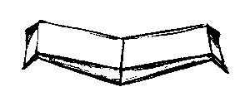
Front view
Step 10:
The Deltry aircraft is a very slow flyer. It is much slower and more graceful than most paper airplanes. Don't throw it. Release it while your hand is moving forward slowly.
©2009, Dr. Jennifer L. Bell, LaGrange High School, LaGrange, Georgia Original Lesson from Nancy Powell, Bloomington High School, Bloomington, Indiana

Slide 14
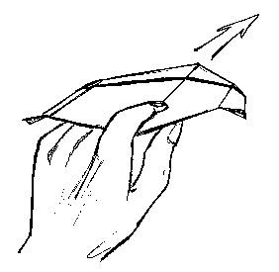
This grip isn't the only way to grip the
Deltry paper airplane, but it's the easiest way. This plane soars at a leisurely pace.
You may want to point it's nose a little downwards as you launch it.
©2009, Dr. Jennifer L. Bell, LaGrange High School, LaGrange, Georgia Original Lesson from Nancy Powell, Bloomington High School, Bloomington, Indiana

Slide 15
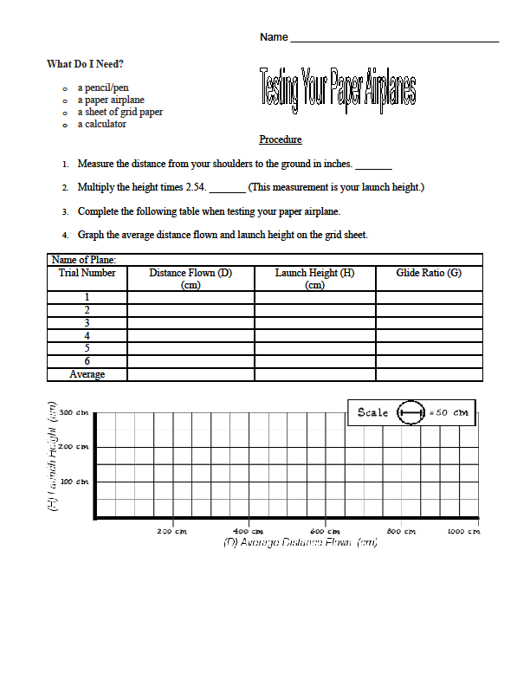
53.5 in.
135.89 cm.
350.00 cm.
135.89 cm.
135.89 cm.
135.89 cm.
135.89 cm.
135.89 cm.
135.89 cm.
135.89 cm.
©2009, Dr. Jennifer L. Bell, LaGrange High School, LaGrange, Georgia Original Lesson from Nancy Powell, Bloomington High School, Bloomington, Indiana

Slide 16
𝜃 = 21.22°
©2009, Dr. Jennifer L. Bell, LaGrange High School, LaGrange, Georgia Original Lesson from Nancy Powell, Bloomington High School, Bloomington, Indiana

Slide 17
Debriefing Questions
1. What is the average angle of depression? __________________________________
2. What types of triangles were created while making the airplane?
_______________________________________
_______________________________________
3. Is the glide ratio the slope of the line? Explain why or why not.
_______________________________________
©2009, Dr. Jennifer L. Bell, LaGrange High School, LaGrange, Georgia Original Lesson from Nancy Powell, Bloomington High School, Bloomington, Indiana

Slide 18
Other materials
©2009, Dr. Jennifer L. Bell, LaGrange High School, LaGrange, Georgia Original Lesson from Nancy Powell, Bloomington High School, Bloomington, Indiana

Slide 19
Procedure
Have your partner measure the distance from the ground to the top of your shoulder with the tape measure. This distance is your launch height, because you will throw your plane from about shoulder height.
Write it on your Flying Things Data Sheet.
Give your plane a gentle toss forward. Your goal is to have it glide smoothly and gently to the ground. To accurately measure your plane’s glide ratio, you have to throw the plane so that it never rises above your shoulder level. Experiment with your throwing technique. Sometimes, a plane will actually fly a shorter distance if you throw it harder.

Slide 20
If your plane doesn’t fly well, make a few adjustments. This is known as trimming your plane. Suggestions:
If the plane dives into the ground, bend up the backs of the wings, but a little bend goes a long way.
If the nose of the plane rises first and then drops, the plane is stalling. Bend down the backs of the wings. Keep your adjustments small.
When it’s your turn, throw your plane.
Record where the nose of your plane lands (measurement) on your Data Sheet.
Test your plane three times. On your Flying Things Data Sheet, record the distance that your plane flew each time.

Slide 21
Data Analysis
For each trial, divide the distance your plane flew by your launch height to get the glide ratio. Round to the nearest tenth. Write the result in the charts.
Calculate your average distance. Add the distance from all trials & divide the sum by the number of trials. Calculate your average glide ratio in the same way.
The side of each square on the grid represents 50 cm. Draw a mark on the vertical side of the grid to show your launch height. Draw a mark on the horizontal side of your grid to show the average distance your plane flew. Connect these two marks to make a right triangle.
The height of the triangle is your launch height.
The base of the triangle is the average distance of your plane’s flight.
The hypotenuse, the longest side of the triangle, shows the approximate flight path of your plane.

Slide 22
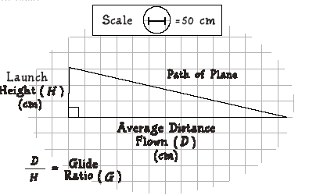

Slide 23
Debriefing Questions
…individually completed on a piece of notebook paper.

Slide 24
How many sets of congruent triangles and parallel lines were created when you folded your airplane?
Look at your charts…. What kinds of things affected the distance that your planes flew? Were you consistently throwing from shoulder height? Did the amount of push affect the distance?
What does the slope of your graph tell you about the distance that your plane flew?
Is the glide ratio the slope of the line showing you the path of the plane? Explain why or why not.
Which plane would you use for the following competitions?

