Slide 1
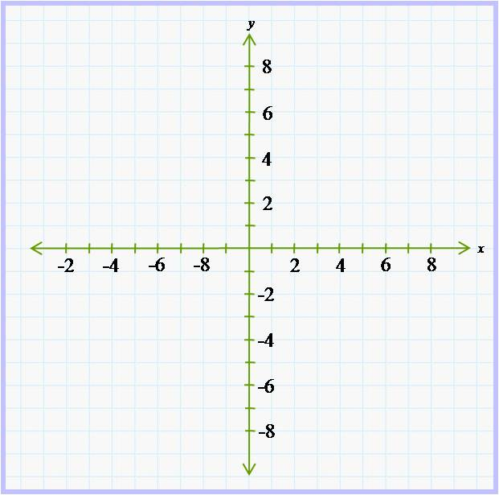
How to find slope
Given 2 points
Given an equation
Graph them.
Count __________.
Use slope formula.
y₂-y₁
x₂-x₁
Change to slope-intercept form.
2x + 5y = 10
If it is in slope-intercept form,
y = 2x + 2
____
m =
© 2011, Dr. Jennifer L. Bell, LaGrange High School, LaGrange, Georgia (MCC9-12.S.ID.7; MCC9-12.F.IF.6)

Slide 2
How to find slope
Given 2 points
Given an equation
Graph them.
Count rise/run.
Use slope formula.
y₂-y₁
x₂-x₁
(4,6) (2,3)
6 - 3
4 – 2
m = 3/2
The slope is 3/2.
Change to slope-intercept form.
2x + 5y = 10
-2x -2x
5y = – 2x + 10
5 5 5
y = -2/5x + 2
y = -2/5x + 2
The slope is -2/5.
If it is in slope-intercept form,
y = 2x + 2
y = 2x + 2
The slope is 2.
____
m =
___________
__ ___ __
Run: To the right 2 units.
(4, 6) (2, 3)
Rise: Up 3 units.
___
m =
The slope is 3/2.
© 2011, Dr. Jennifer L. Bell, LaGrange High School, LaGrange, Georgia (MCC9-12.S.ID.7; MCC9-12.F.IF.6)

