Slide 1
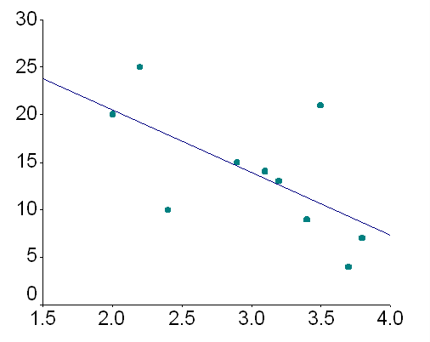
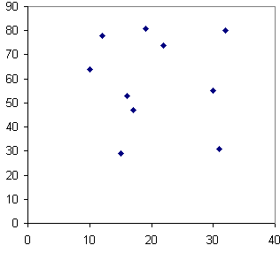
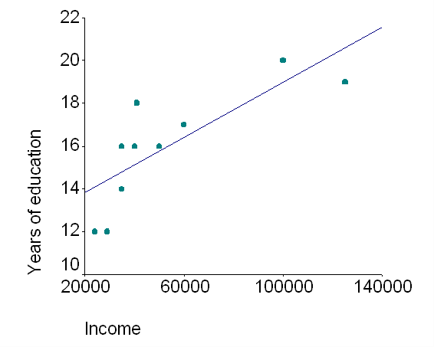
correlation coefficient
© 2010, Dr. Jennifer L. Bell, LaGrange High School, LaGrange, Georgia (MCC9-12.S.ID.8)

Slide 2
correlation coefficient
a measure of the strength and direction of a relationship (or association)
negative
correlation
r = -1
n0
correlation
r = 0
positive
correlation
r = 1
© 2010, Dr. Jennifer L. Bell, LaGrange High School, LaGrange, Georgia (MCC9-12.S.ID.8)

