Slide 1
Body Modeling Lab Activity
Original author unknown.
Adapted by Dr. Jennifer L. Bell, LaGrange High School, LaGrange, GA, ©2010
(MCC9-12.A.CED.2; MCC9-12.F.IF.4)

Slide 2
Objective: Collect data, create a scatter plot of the data, and find the equation of "best-fit".
Materials: Lab sheet, marker, graphing calculator, “smart” cookie, hand, and mouth.
Activity #1 – Hand Modeling
Step 1 – Use the grid below to trace around your hand with a marker. Make sure your fingers
are together so that no space is between them and your hand is perpendicular to the bottom of the lab sheet. Trace from the widest part of your hand's left side to the widest part of the right side. You may trace your hand in any grid quadrant(s).

Slide 3
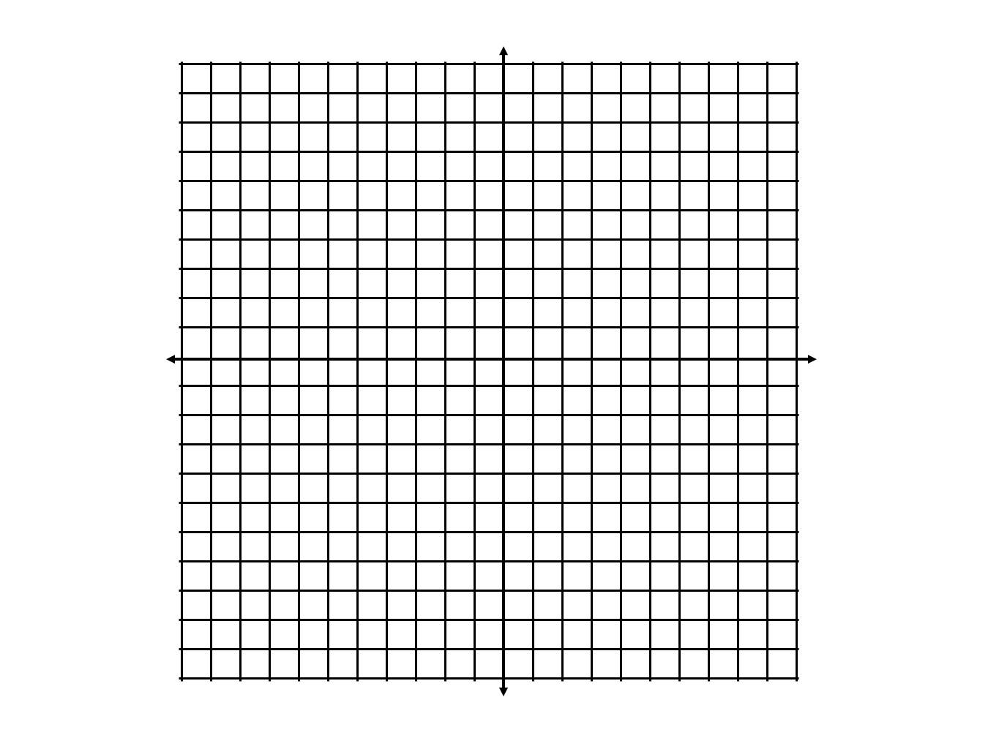
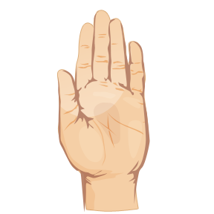

Slide 4
Step 2 – Select 11 points around the tracing of your hand which intersect at grid lines. List your selected coordinates in the table provided below.
X | Y

Slide 5
Step 3 – Input your data in a graphing calculator, create a scatterplot of the data, and find the
regression equation that best fits your hand tracing.
Record your equation: _____________________

Slide 6
Questions
Identify each of the following characteristics for your graph.
Maximum _______________
Minimum _______________
Interval of increasing _______________
Interval of decreasing _______________
x-intercept(s) _______________
y-intercept _______________
End behavior _______________
Line of symmetry _______________

Slide 7
Activity #2 – Foot Modeling
Step 1 – Use the grid below to trace around your foot with a marker. Make sure your toes
are together so that no space is between them and your foot is perpendicular to the bottom of the lab sheet. Trace from the widest part of your foot's left side to the widest part of the right side. You may trace your foot in any grid quadrant(s).

Slide 9
Step 2 – Select 11 points around the tracing of your hand which intersect at grid lines. List your selected coordinates in the table provided below.
X | Y

Slide 10
Step 3 – Input your data in a graphing calculator, create a scatterplot of the data, and find the
regression equation that best fits your hand tracing.
Record your equation: _____________________

Slide 11
Questions
Identify each of the following characteristics for your graph.
Maximum _______________
Minimum _______________
Interval of increasing _______________
Interval of decreasing _______________
x-intercept(s) _______________
y-intercept _______________
End behavior _______________
Line of symmetry _______________

Slide 12
Activity #3 – Mouth Modeling
Step 1 – Take a large bite of the “smart” cookie. Place the remaining portion of your cookie anywhere on the grid below. Make sure that the bite mark faces either up or down, not left or right. Trace around your inside bite mark with a marker.

Slide 13
Step 2 – Select 9 points around the tracing of your bite mark which intersect at grid lines. List your selected coordinates in the table provided below.
Step 3 – Input your data in a graphing calculator, create a scatterplot of the data, and find the
regression equation that best fits your bite mark tracing.
Record your equation: ______________________

Slide 14
Questions
Identify each of the following characteristics for your graph.
Maximum _______________
Minimum _______________
Interval of increasing _______________
Interval of decreasing _______________
x-intercept(s) _______________
y-intercept _______________
End behavior _______________
Line of symmetry _______________

